Slide 1
Mars

Slide 2
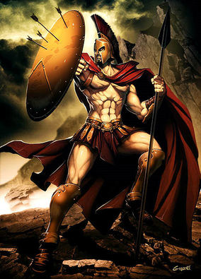
Named for…
Mars, the Roman God of War
functions encompassed love, beauty, desire, sex, fertility, prosperity, and victory.

Slide 3
The Stats
Mass: 5.97 x 10²⁴ kg 15% the mass of Earth
Radius: 6371 km
Distance from the Sun: 238.21 million km
Gravity: 3.711 m/s²

Slide 4
More STats
Mars is visible from the Sun!
Brightness Magnitude: -2.6
When and Where: In the evening sky from January through April and in the morning sky from November through December.

Slide 5
Moons!!!
Mars has 2 moons: Phobos and Deimos
Discovered in 1877
Carbon-rich rock and ice covered in dust and loose rocks
Phobos will crash into Mars in 30 – 50 million years

Slide 6
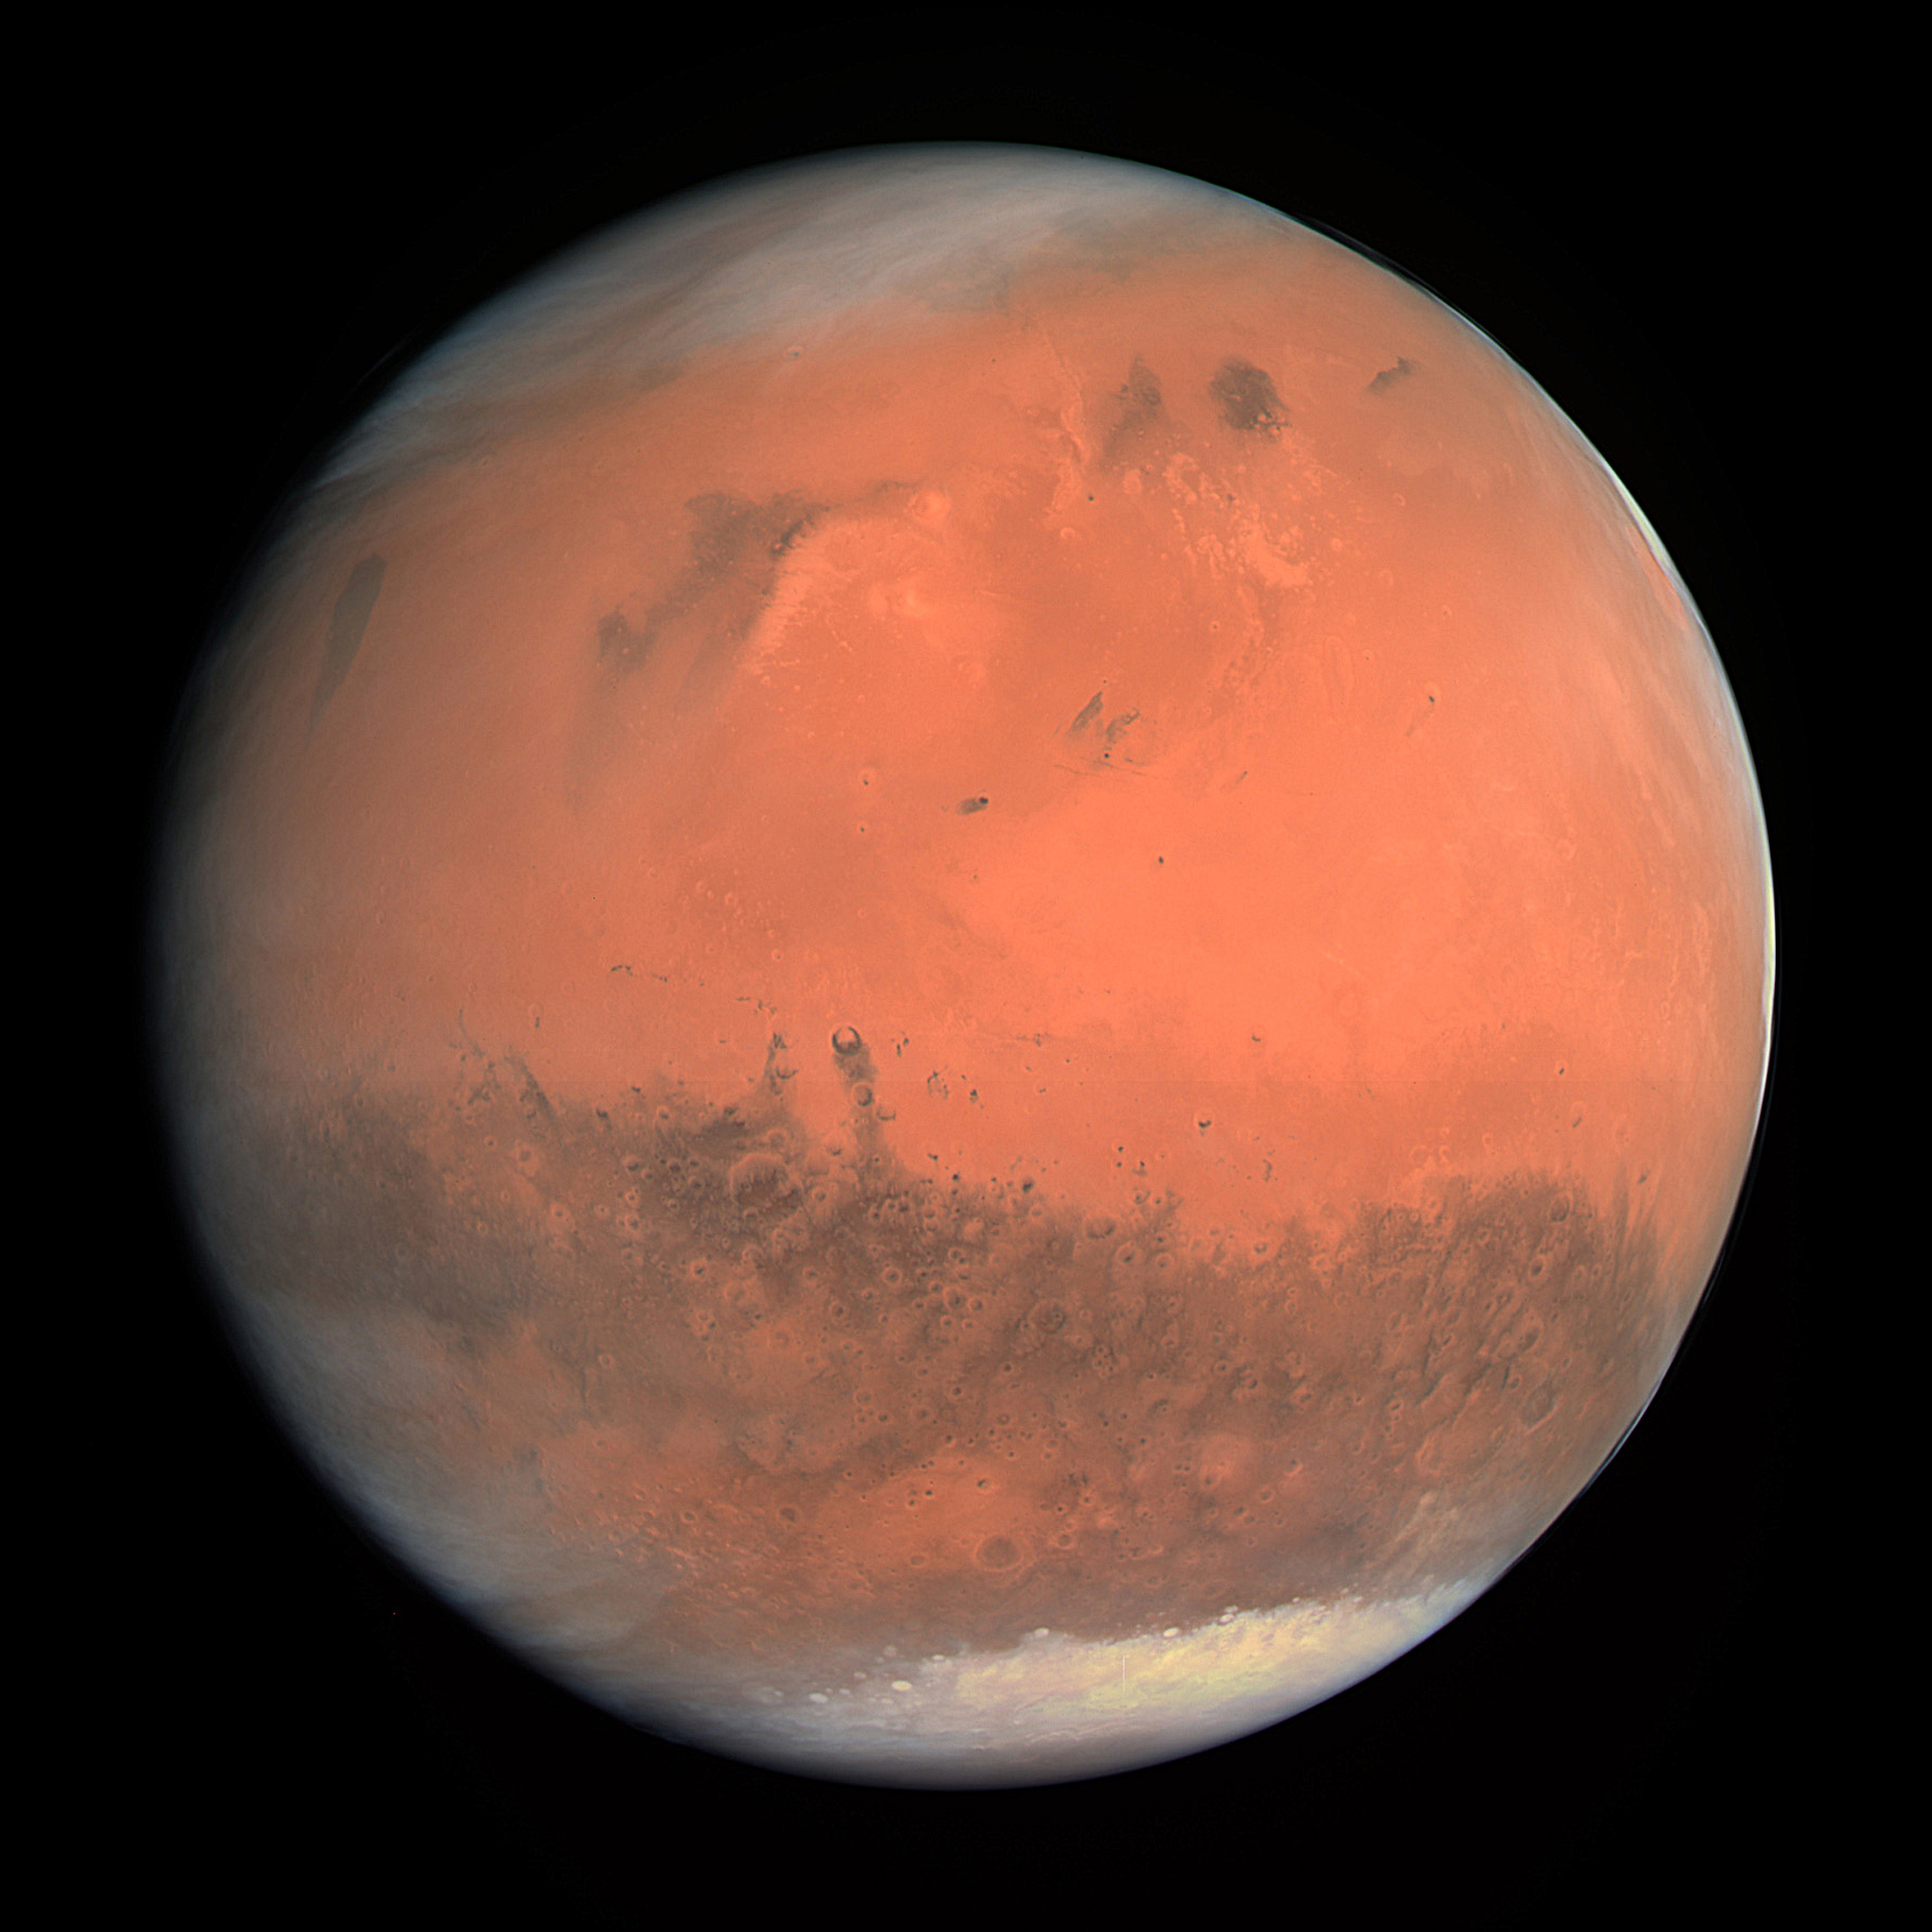
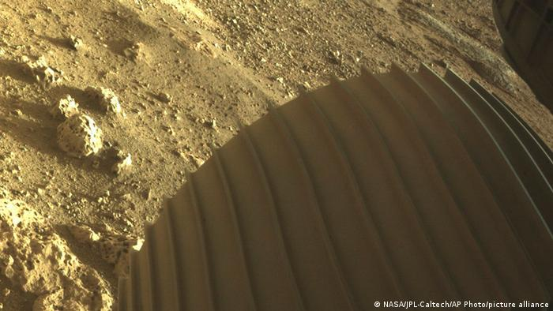

Slide 7
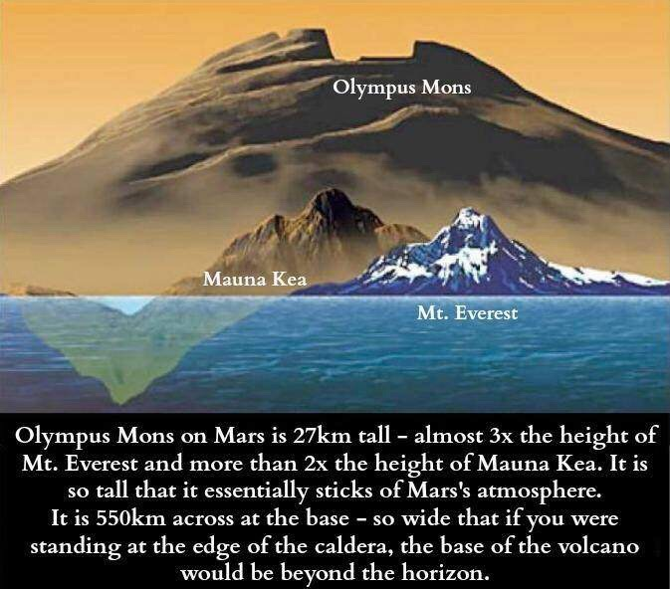
Surface
Rocky terrain with mountains, volcanoes, channels, valleys, and gullies
There is also some flat, low lying terrain
Lots of impact craters
Erosion from when there was liquid water on Mars
Largest volcano in the solar system – Olympic Mons
27 km (17 miles) tall
370 miles in diameter

Slide 8
Atmosphere & Temperature
Average temperature: -63 degrees C (ranges from -125 to 20 degrees)
Mostly carbon dioxide and methane gas
100 times less dense that Earth’s atmosphere
Has weather, clouds, and wind
Clouds are made of carbon dioxide
Big dust storms that last for months!

Slide 9
Interior
Has no magnetic field
Solid core of iron, nickel, and sulfur
Mantle is similar to Earth’s mantle
Crust is volcanic basalt and silicate rock

Slide 10
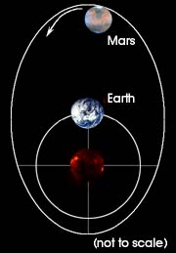
Rotation
A day on Mars lasts 24 Earth hours & 37 minutes
A year on Mars is 687 Earth days
Its orbit is very elliptical
Seasons on Mars are extreme
Northern hemisphere – long, mild summers & short, cold winters
Southern hemisphere – short, very hot summers & long, very cold winters

Slide 11
Mission to Mars!
We have been sending probes and rovers to mars since the 1960s
So has Russia, India, and Japan
Perseverance rover landed on Mars on February 18, 2021
Start video at 1 hour 40 seconds

Slide 12
Interesting facts
Mars lost its atmosphere when it lost its magnetic field
We just heard the 1st sounds of wind on Mars

