Slide 1
Earth

Slide 2
Named for…
No one.
Comes from the English and German words: ‘ear(th)e and erda – means ground.
It’s the only planet that is not named after a Greek or Roman god or goddess

Slide 3
The Stats
Terrestrial planet
Mass = 5.972 × 10²⁴ kg
Radius = 6378 km
Distance to the Sun = 150 million km
Gravity = 9.807 m/s²

Slide 4
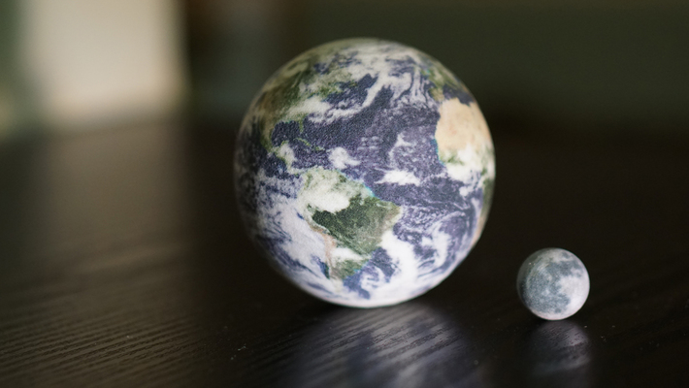
Earth has 1 moon, named Moon.

Slide 5
Size and Shape
Any object with a radius of 250km or larger will be spherical in space because of gravity
Gravity crushes/deforms rock into a round shape
Earth is NOT a perfect sphere, it bulges out at the equator

Slide 6
Surface: The Crust
Element | Oxygen (O) | Silicon (Si) | Aluminum (Al) | Iron (Fe) | Calcium (Ca) | Magnesium (Mg) | Sodium (Na) | Potassium (K) | Titanium (Ti) | Hydrogen (H) | Others
% of the crust | 46% | 28% | 8% | 6% | 4% | 2% | 2% | 2% | 0.6% | 0.1% | 1%

Slide 7
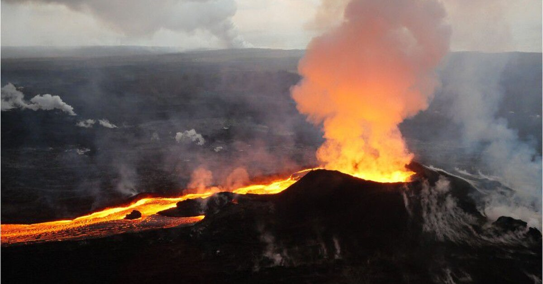
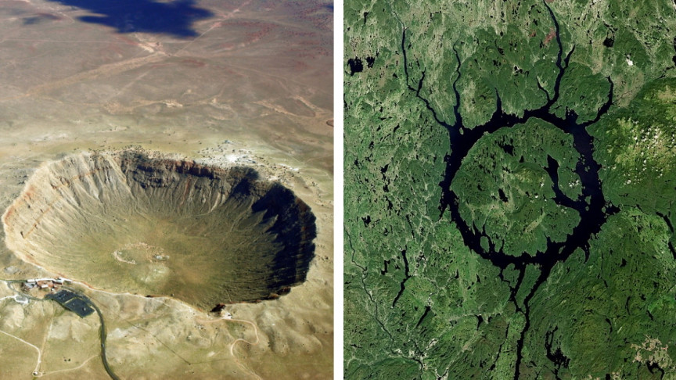
Surface
Has active volcanoes
Has impact craters

Slide 8
Temperature and Atmosphere
Gaseous layer extends 140km above the surface, getting thinner as you go up
Troposphere – lowest level, surface up to 12km. It where clouds & airplanes are
Stratosphere – 12 to 48km up, contains the protective ozone layer

Slide 9
Atmosphere contains
Gas | %
Nitrogen (N₂) | 78.08%
Oxygen (O₂) | 20.95%
Argon (Ar) | 0.93%
H₂O (g) | Varies 0.1 – 3%
CO₂ (g) | 0.039%
Trace gases – Neon, Helium, Ozone, Krypton, Hydrogen, Methane, Carbon monoxide, & Pollutants) | < 0.01%

Slide 10
Greenhouse Effect
Sunlight penetrates our atmosphere and energy from its photons get absorbed by surface and warm up. The surface then radiated infrared radiation back into the atmosphere. The H₂O and CO₂ traps that extra heat in the atmosphere and Earth heats even more
Global Warming – unnatural build up of CO₂ in the atmosphere which is rapidly heating the planet

Slide 11
Origin of the Atmosphere: 2 theories
1st Theory
Gases were original trapped in material that made the earth & escaped when Earth heated thru volcanic activity or asteroid impacts
2nd Theory
Gases are not original to Earth but were brought by comets hitting the it

Slide 12
What really happened?
It was probably a combination of the two theories
Just formed Earth: Like Earth, the hydrogen (H₂) and helium (He) were very warm. These molecules of gas moved so fast they escaped Earth's gravity and eventually all drifted off into space.

Slide 13
What really happened?
Young Earth: Volcanoes released gases H₂O (water) as steam, carbon dioxide (CO₂), and ammonia (NH₃). Carbon dioxide dissolved in seawater. Simple bacteria thrived on sunlight and CO₂. By-product is oxygen (O₂).

Slide 14
What really happened?
Current Earth: Plants and animals thrive in balance. Plants take in carbon dioxide (CO₂) and give off oxygen (O₂). Animals take in oxygen (O₂) and give off CO₂. Burning stuff also gives off CO₂.

Slide 15
Temperature
57 ° F (14°C or 287K)

Slide 16
Interior
Crust- surface layer
Mostly made of silicate rocks
Mantle – below the crust
Extends ½ way to Earth’s center
Made of silicates
Solid but it can flow if stressed
Outer core
Liquid iron and nickel
Very dense
Inner core
Solid iron and nickel
Extremely hot but high pressure keeps it solid

Slide 17
Interior
Temperature of the interior heats by 2° for every 100m you descend
Earth is very slowing cooling down
Earth is about 4.5 billion years old

Slide 18
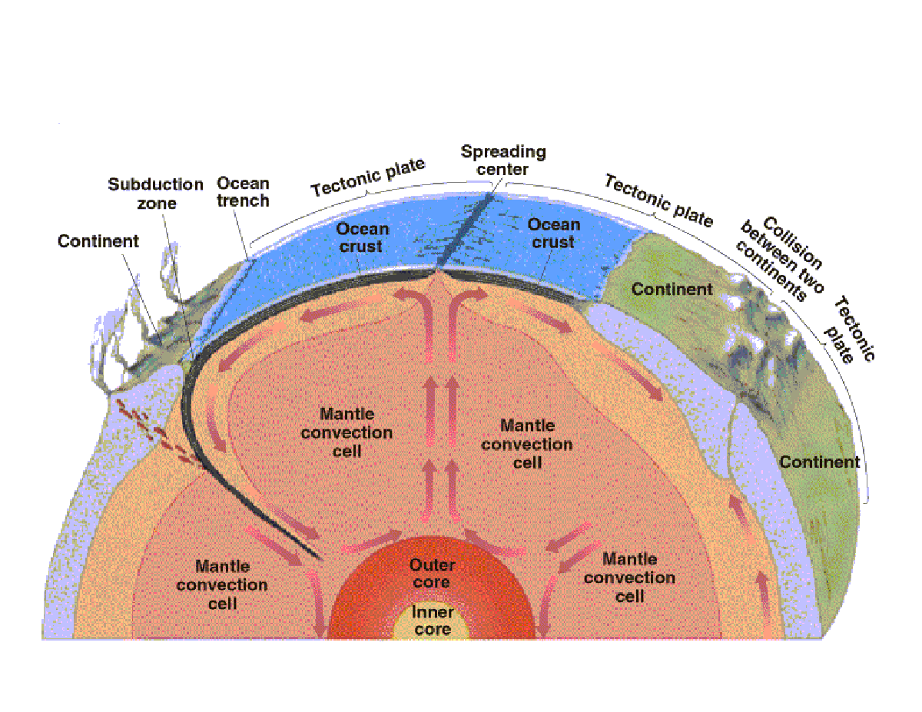
Interior: Convection Heating

Slide 19
Plate Tectonics

Slide 20
Plate Tectonics

Slide 21
Earth’s Magnetic Field

Slide 22
Origin of Earth’s magnetic field

Slide 23
Rotation
Length of a day = 23 hours & 56 minutes
Length of a year = 365.25 days
It’s orbit precesses – the Earth “wobbles” & makes a complete spin every 26,000 years
Causes ice ages because the Earth gets really cold in winter at specific parts of the wobble

Slide 24
Interesting Facts & Peculiarities
70% of Earth is covered by water
Has 1 moon and 2 satellites
3753 Cruithne (5000m diameter)
2002 AA₂₉ (60 m diameter)
Once has a 2nd moon but it collided with our current moon

