Slide 1
Unit 3: The Solar System: an overview

Slide 2
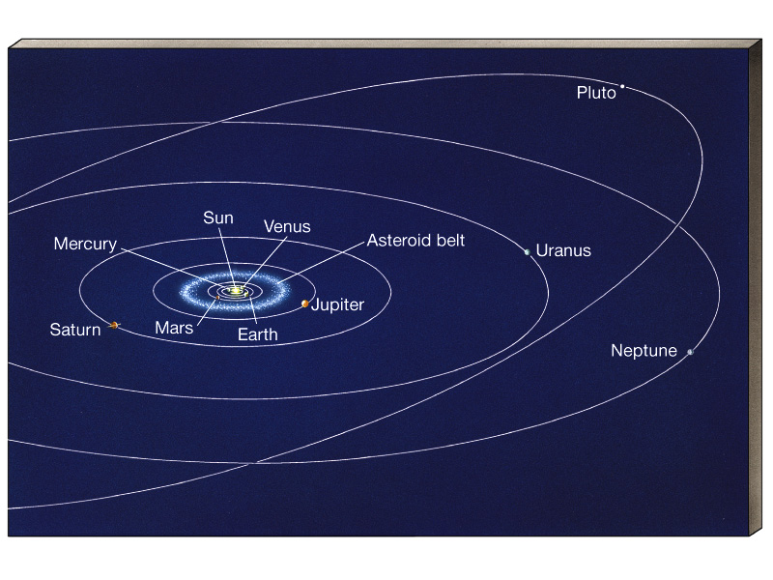
The Solar System
star
9 planets
(major) moons
asteroids, comets, meteoroids

Slide 3
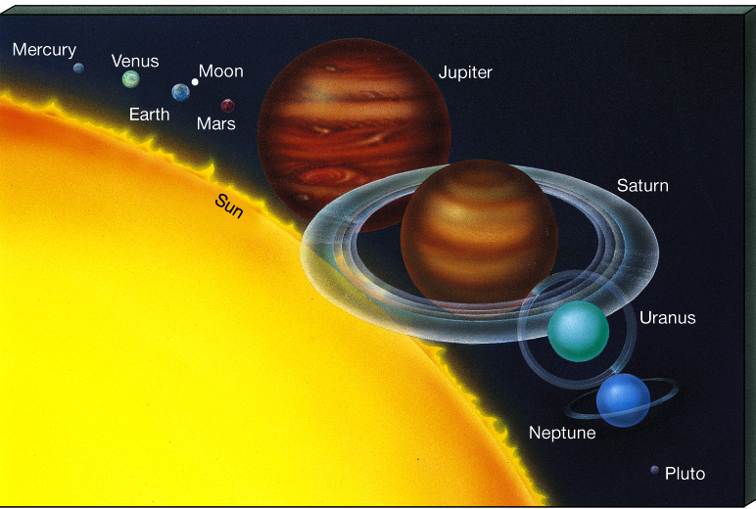
The to planets are known from Kepler’s Laws
(once calibrated with radar ranging to Venus)
How are planet sizes determined?
Measure on sky,
Then use geometry…..

Slide 4
Formation of the Solar System
Any theory to describe the formation of our Solar System must adhere to these facts:
Each planet is in space
The orbits are circular
The orbits of the planets all lie in roughly the plane.
The direction they orbit around the Sun is the as the Sun’s rotation on its axis
The direction most planets rotate on their axes is the as that for the Sun
The direction of a planet’s moon orbits is the same as that planet’s direction of _____________
The ___________planets are very different from the __________ planets
Asteroids are different from both types of planets
Comets are _____fragments that don’t orbit in the ________plane

Slide 5
Nebular Theory for Solar System formation
Our sun and the planets began from a cloud of dust and gas (_______)
As the cloud contracts under its own ______, the Sun is formed at the center.
The cloud starts to ____ and the smaller it contracts, the faster it spins.
Conservation of angular momentum
Cloud forms a flattened, ________ shape.

Slide 6
We’ve seen these disks around other young stars!
Beta Pictoris

Slide 7
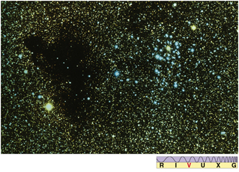
Condensation Theory for Planet Formation
The ______ in the flattened nebula would never eventually clump together to form planets.
________________________(grain-size particles) lies between stars - remnants of old, dead stars.
These dust grains form ____________________________- other atoms attach to them to start the “collapsing” process to form the planets in the gas cloud.

Slide 9
What happened next…..
A flattened solar nebula disk exists after cloud spins and contracts
Condensation nuclei form clumps that grow into moon-size ______________
_________________from star formation (Sun forming) blow out the rest of the gas
Planetesimals ____________ and grow
Planetesimals form the basic planets over hundred million years

Slide 11
__________ - determined through observing the gravitational effect of the planet on some nearby object (moons, nearby planets, satellites)
__________ - divide mass by volume
Planets orbit the sun __________ __________ as seen from the North Celestial Pole.
All planets are in the same orbital plane _________ Mercury and Pluto.

Slide 12
___________ Planets
__________ Planets
Mercury, Venus, Earth and Mars
Close to Sun
Small masses, radii
Rocky, solid surfaces
High densities
Slow rotation
Weak magnetic field
No rings
Few moons
Jupiter, Saturn, Uranus, and Neptune
Far from Sun
Large masses and radii
Gaseous surface
Low densities
Fast rotation
Strong magnetic field
Many rings
Many moons

Slide 13
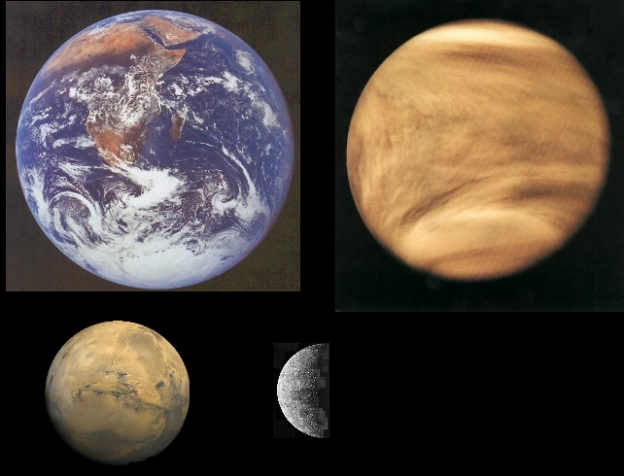
Terrestrial planets

Slide 14
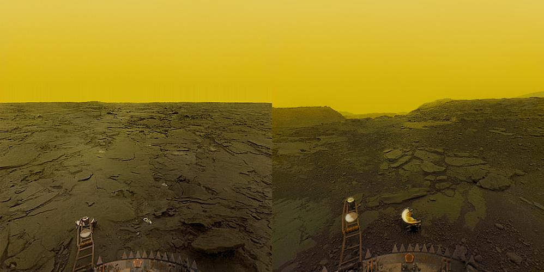
Surface of Venus as seen from the Venera probe

Slide 15
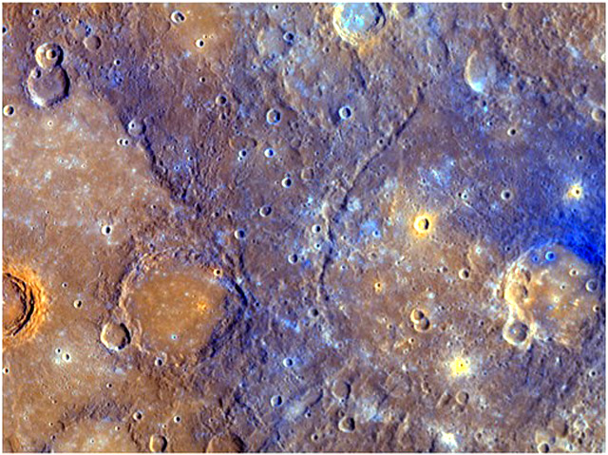
Mercury

Slide 16
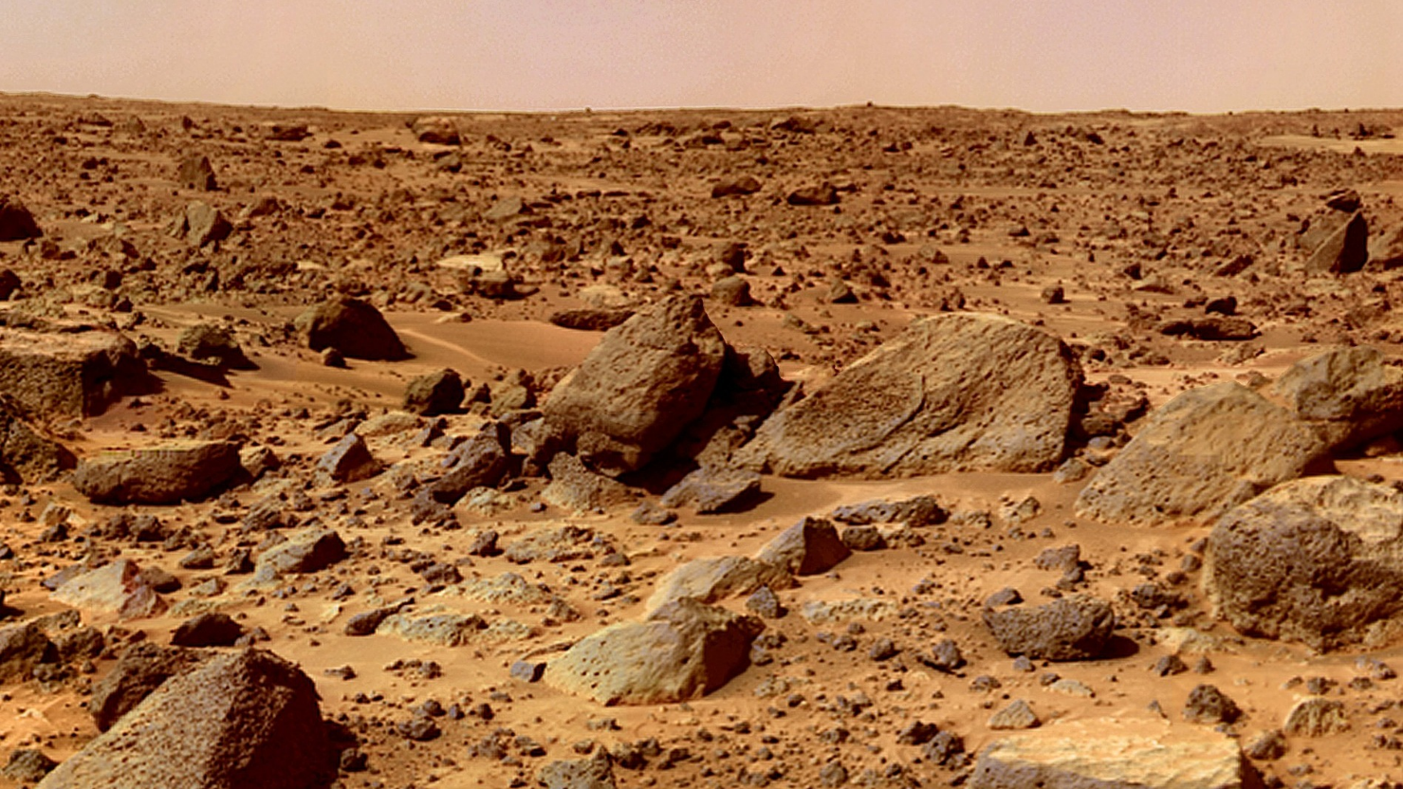
Mars

Slide 17
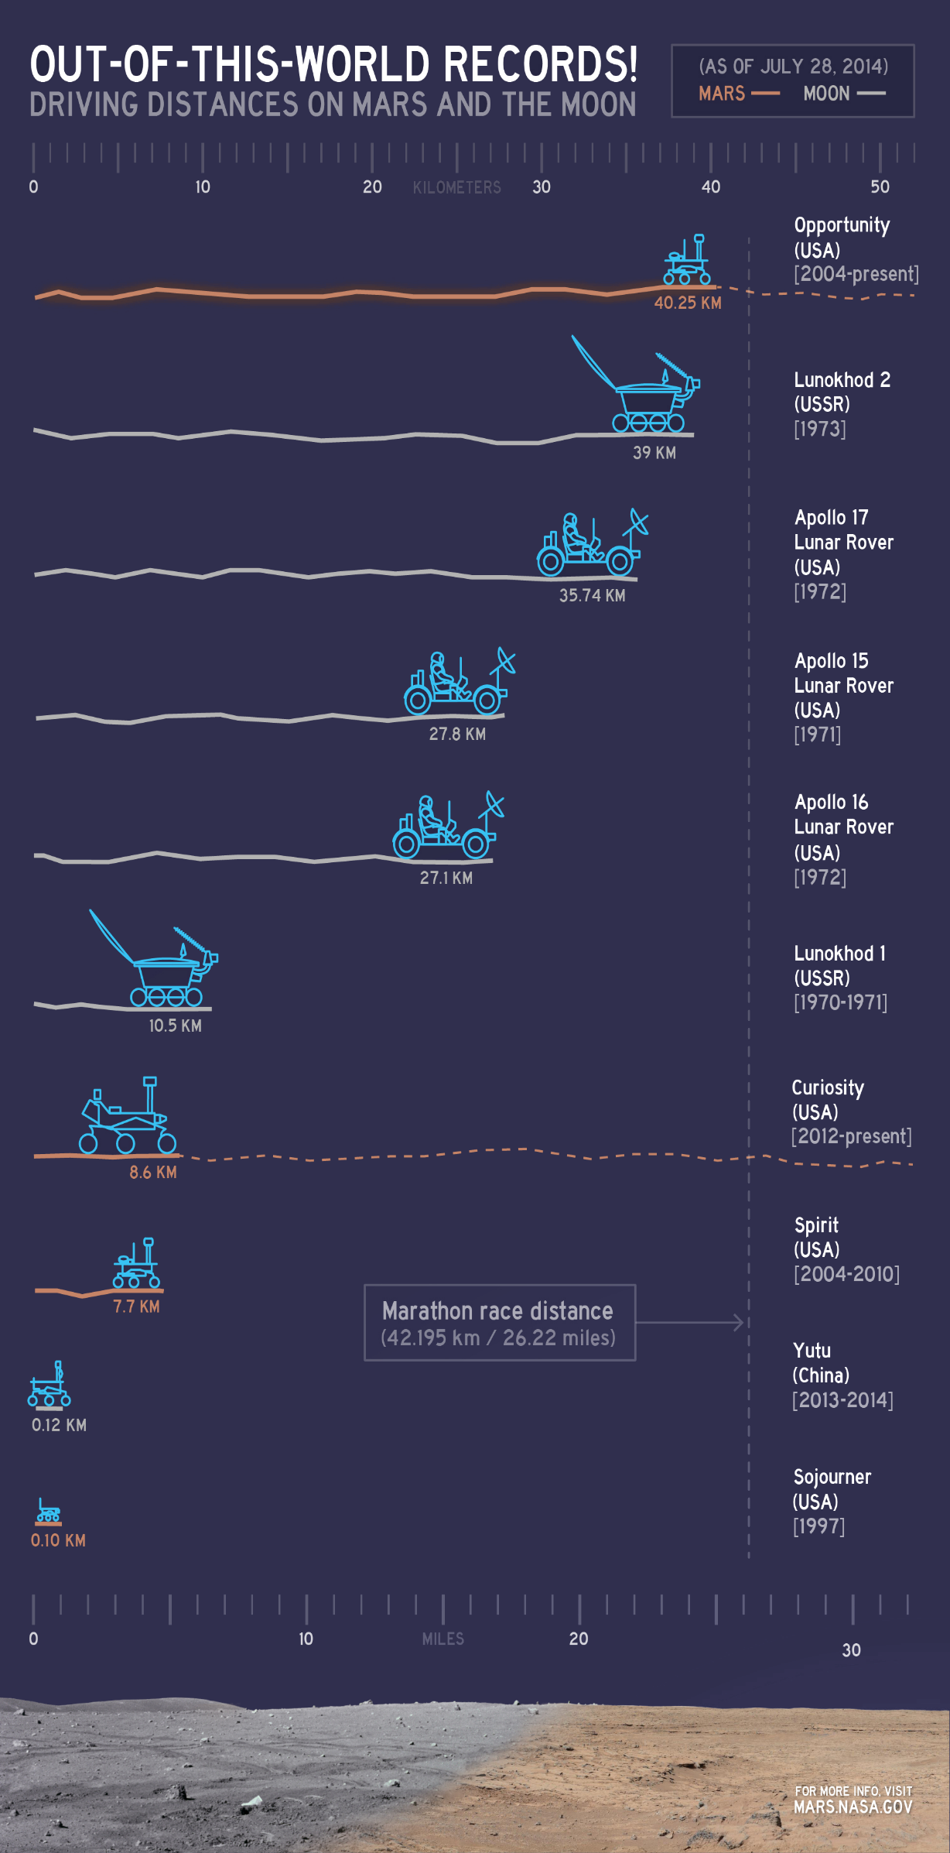

Slide 19
Exploration
Spirit and Opportunity- ___________in 2003 Mission was to detect signs of ________
Spirit- currently __________ as of 2010
Opportunity- functioned from 2004 - ______

Slide 20
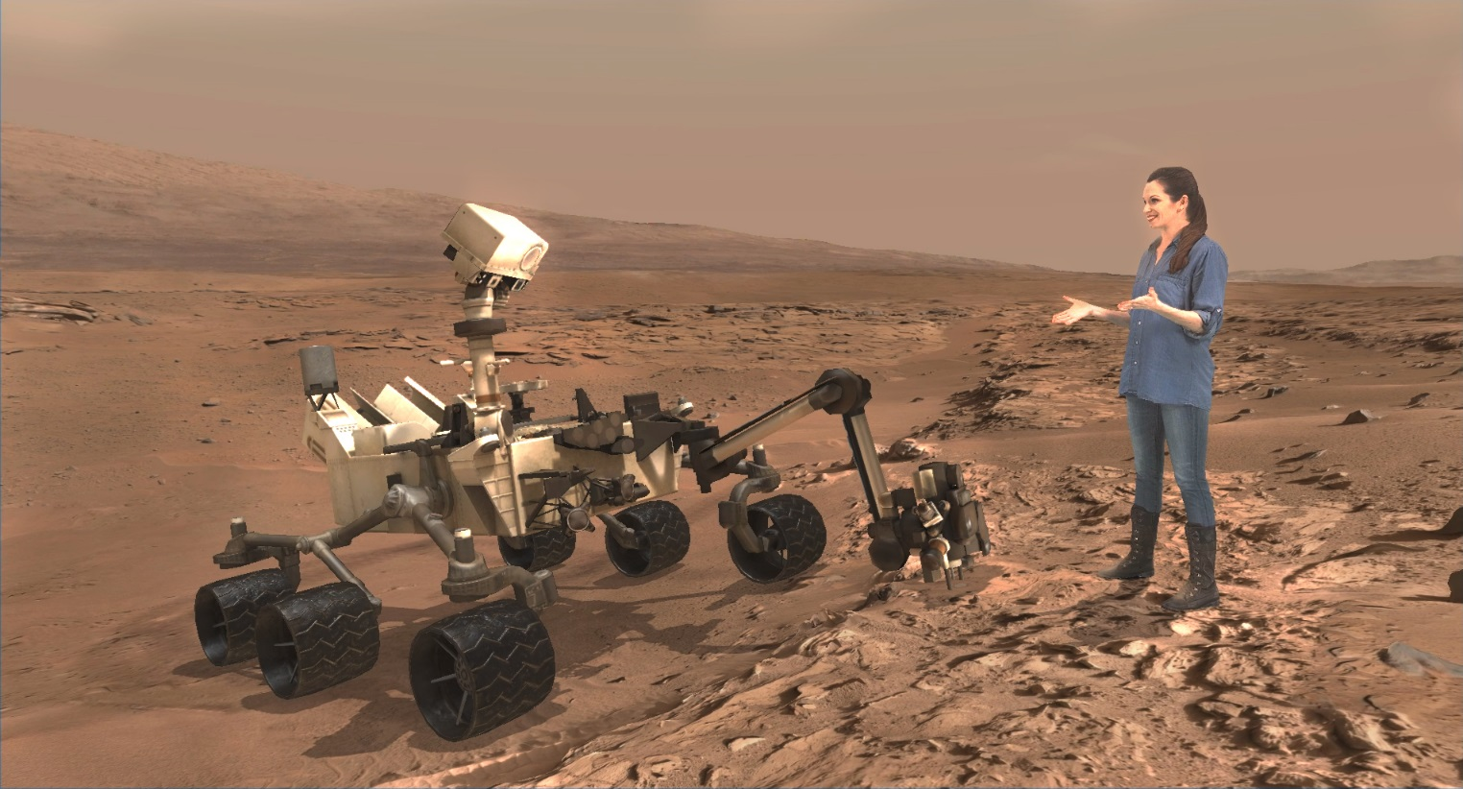
Curiosity
Launched August 2012:
Has Detected ___________On Mars (indicative of ___________)

Slide 21
Mission Implications
Demonstrated the _____________ to land a very large, heavy rover to the surface of Mars
Demonstrated the ability to land more ____________ in a 20-kilometer (12.4-mile) landing circle
Demonstrated long-range _______________on the surface of the red planet (5-20 kilometers or about 3 to 12 miles) for the collection of more diverse samples and studies.

Slide 22
Mars Long term Plans
Determine whether _______ ever arose on Mars
Characterize the _________ of Mars
Characterize the _________of Mars
Prepare for _________ Exploration

Slide 23
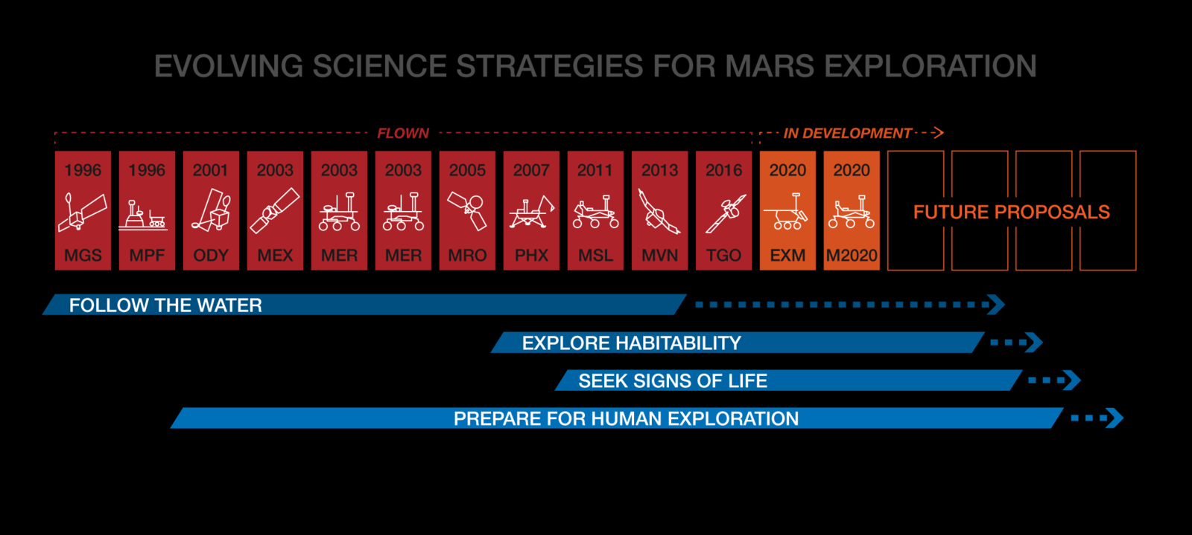
Future Mars Time Table

Slide 24
Venus- Venera 13 Russian Launch
________ Minutes after landing

Slide 25
Jupiter
JUNO-
Determine how much ________ is in Jupiter's atmosphere, which helps determine which planet formation theory is correct (or if new theories are needed)
Look deep into Jupiter’s _______________ to measure composition, temperature, cloud motions and other properties
Map Jupiter’s _______________ and gravity fields- structure insight
Explore and study Jupiter's magnetosphere near the planet’s_______________, especially the auroras and atmosphere

Slide 26
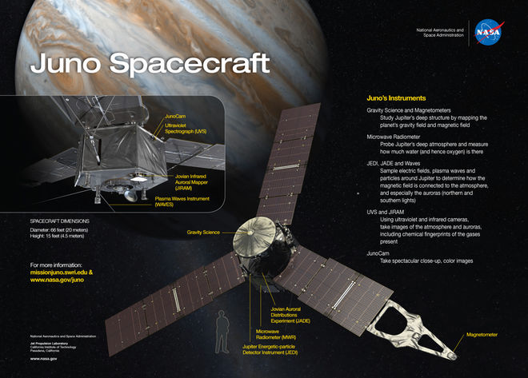

Slide 27
Saturn: Cassini
Exploration of Saturn’s moons and atmosphere on Saturn
The ____________probe makes first landing on a moon in the outer solar system (Titan)
Discovery of active, ____________ plumes on the Saturnian moon Enceladus
Saturn’s ___________ revealed as active and dynamic -- a laboratory for how planets form
Titan revealed as ___________-like world with rain, rivers, lakes and seas
Studies of the great northern ____________ of 2010-2011

Slide 28
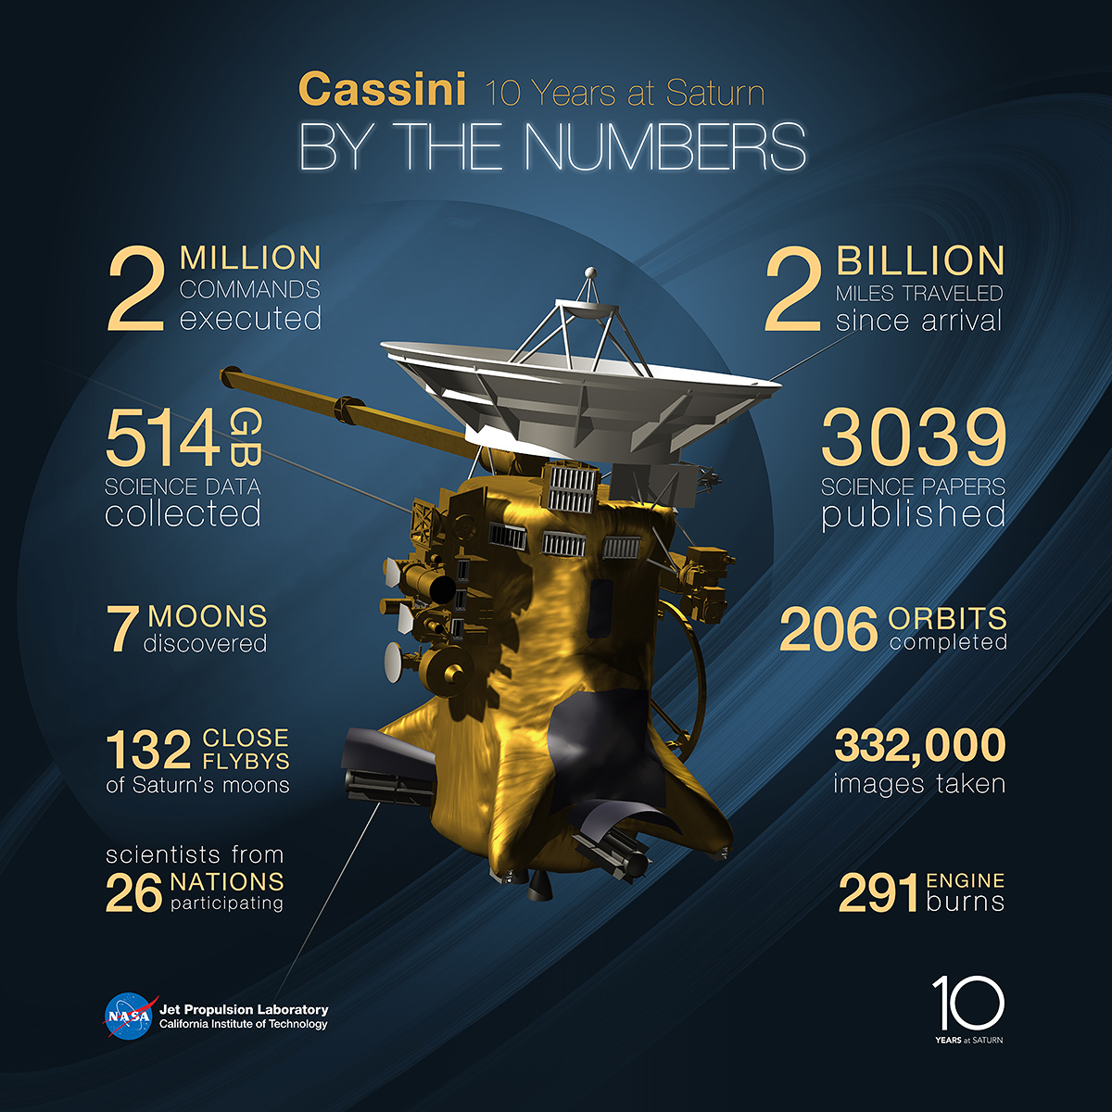

Slide 29
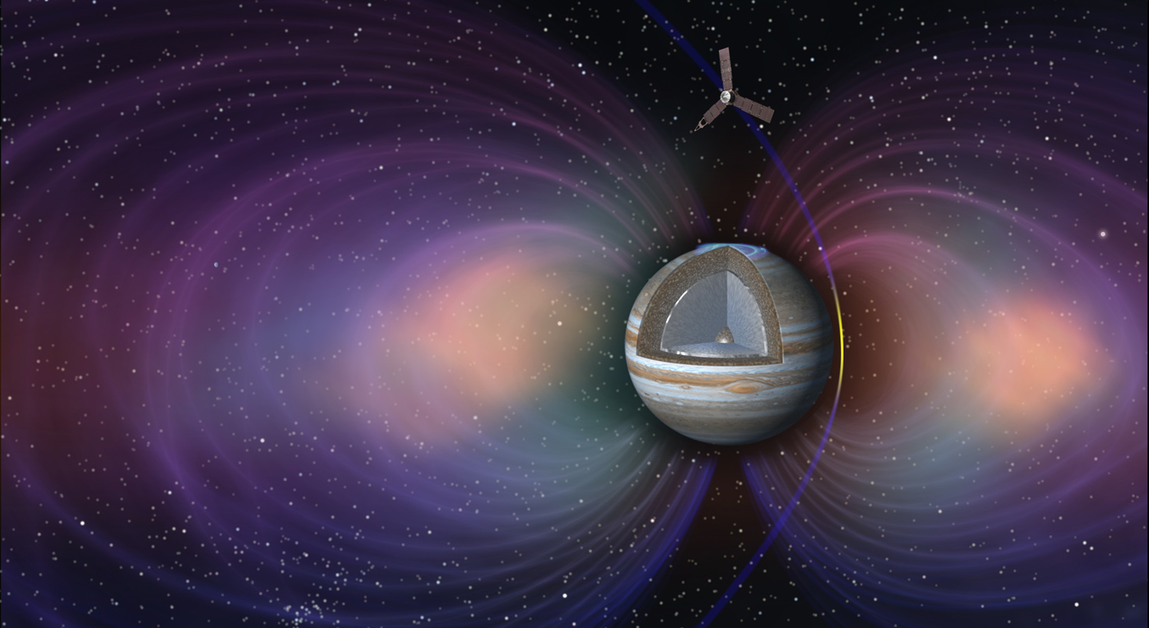

Slide 30
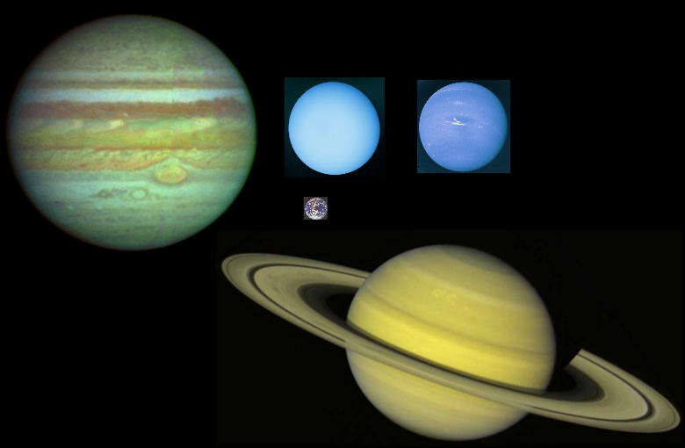
Jovian planets (and earth)

Slide 31
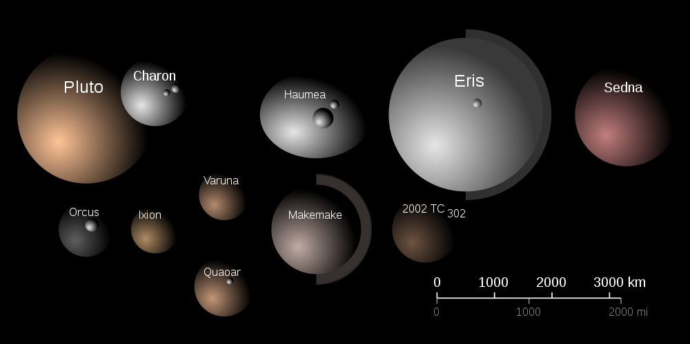
OTHER SOLAR SYSTEM OBJECTS

Slide 32
Dwarf Planet Qualifications
_________ enough to be rounded by its own gravity
But has ______cleared its neighboring region of planetessimals
Is not a ____________

Slide 33
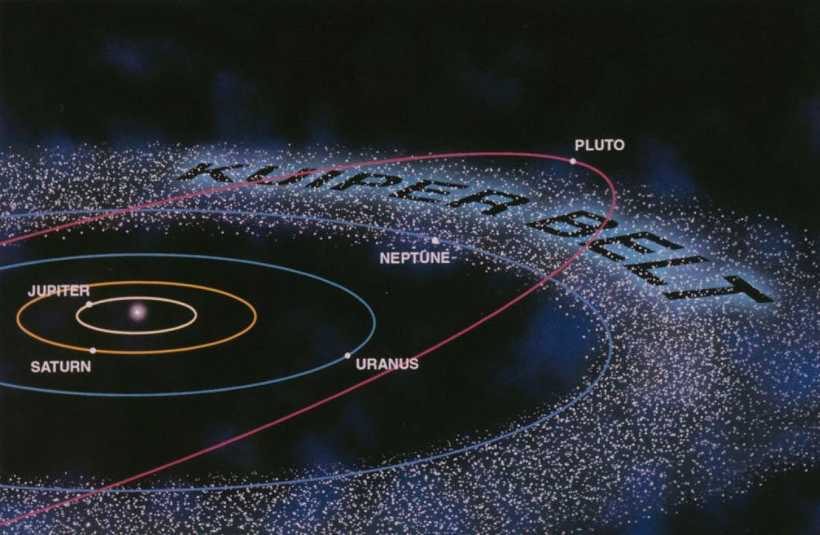
Trans Neptunian
A _________________ is dwarf planet beyond the orbit of Neptune

Slide 34
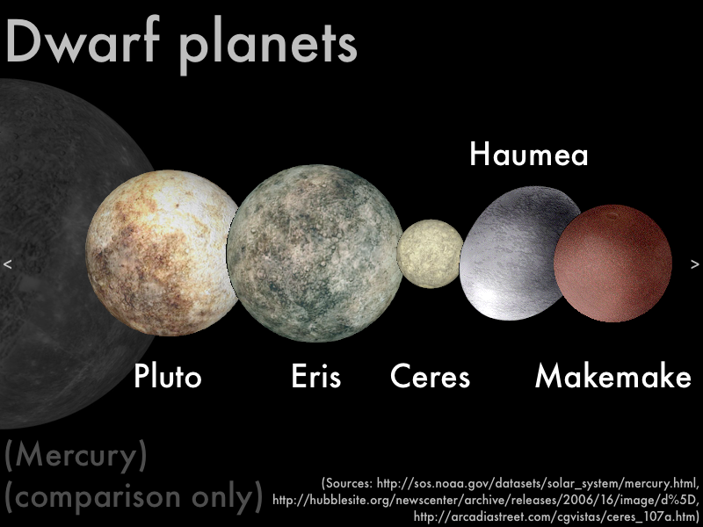
By the numbers
Only ____ Dwarf Planets recognized so far but there may be as many as ______

Slide 35
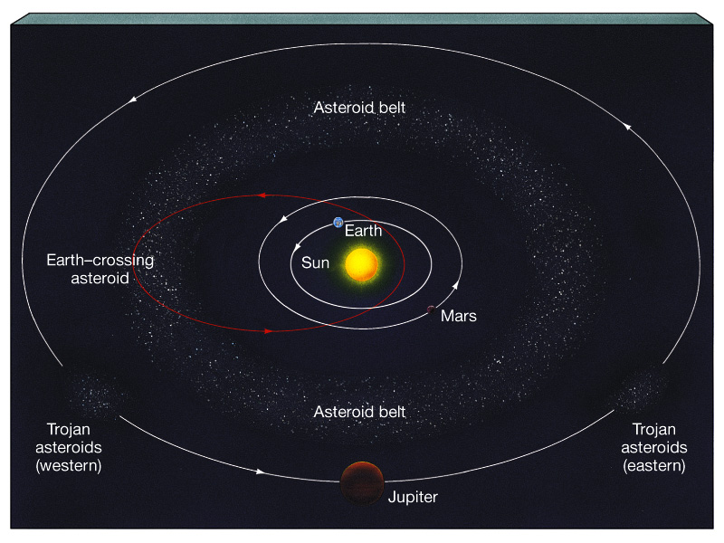
Asteroids - rocks with sizes greater than _________ across
Most asteroids remain in the ________ belt between Mars and Jupiter but a few have orbits that cross Earth’s path.
Three asteroids hit the Earth every _____________years!

Slide 36
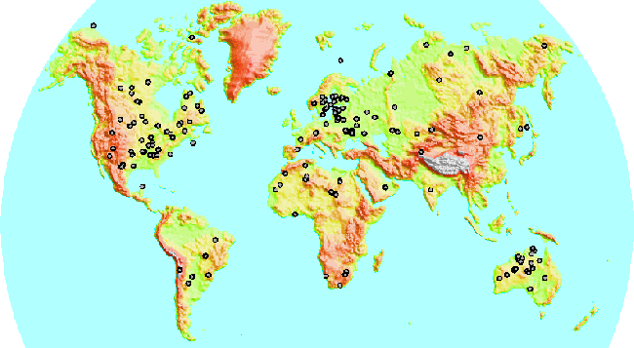
Known asteroid impact sites

Slide 38
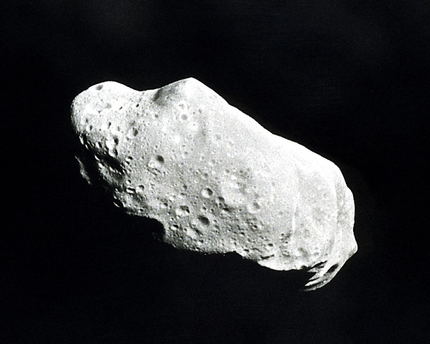
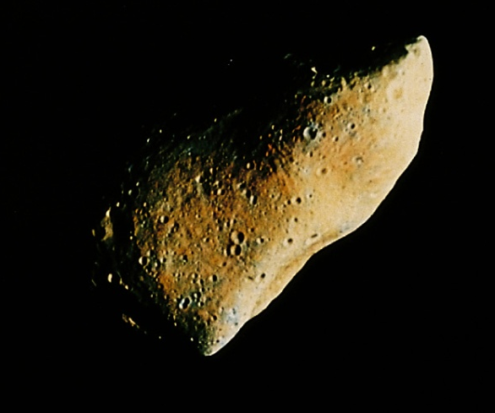
Asteroid sizes range from 100m to about 1000km
They are composed of ________ or __________ and other rocky material.
The Asteroid belt is a group of rocks that appear to have_________joined to make a planet. Why do we think this?
Too little __________ to be a planet
Asteroids have different chemical compositions
It’s all ________________ fault…..

Slide 39
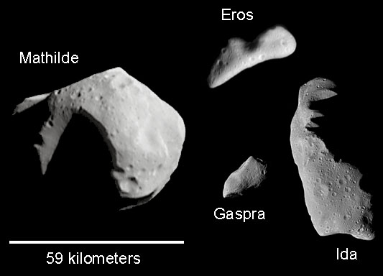

Slide 40
Meteoroids – interplanetary rocky material __________ than 100m (down to grain size).
called a __________ as it burns in the Earth’s atmosphere
if it makes it to the ground, it is a ____________
Most meteor showers are the result of the Earth passing through the orbit of a _________ which has left debris along its path

Slide 41
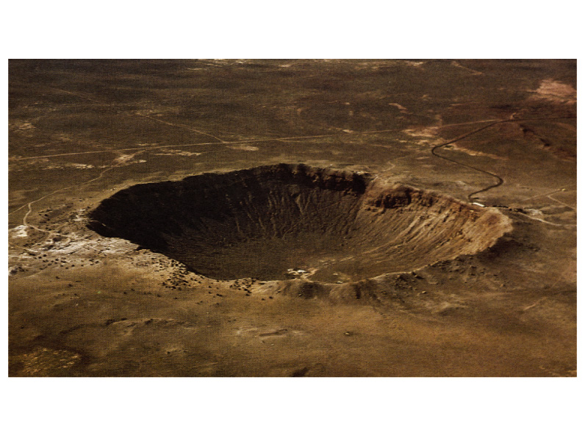
Meteors are _______ - mainly iron and nickel
Some contain ____________ material - rich in organic material
Meteors are _____ - 4.5 billion years - based on carbon dating
Meteor crater near Winslow, AZ - the culprit was probably 50 m across weighing 200,000 tons!
Meteor showers:
Lyrid – Apr 21/22
Eta Aquariid – May 4/5
Orionid – Oct 20/21
Leonid – Nov 16/17
Geminid – Dec 13/14

Slide 42
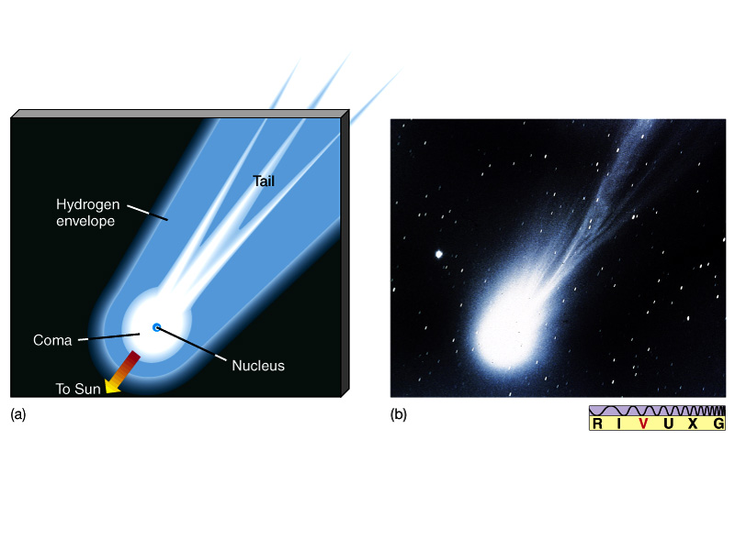
Comets
________ snowballs - dust and rock in methane, ammonia and ice
All light is reflected from the Sun - the comet makes no light of its own
Halley’s Comet in 1986
The nucleus is a few km in diameter

Slide 43
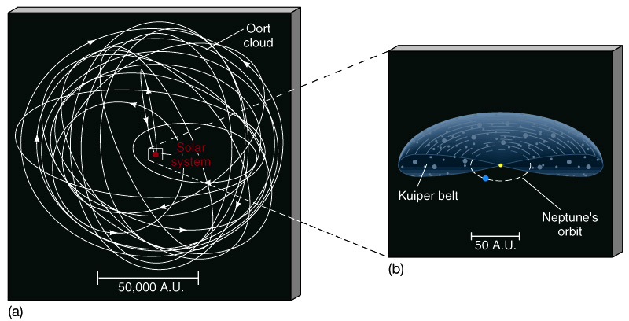
Cometary ________ take them far beyond Pluto
Many take up to ___ million years to orbit the Sun once!
Short period comets (< 200 years) (like Halley’s comet)
These long period comets probably originate in the _____________
Short period comets may have originated in the _______________
Kuiper belt comet gets “kicked” into an eccentric orbit, bringing it into the solar system

Slide 44
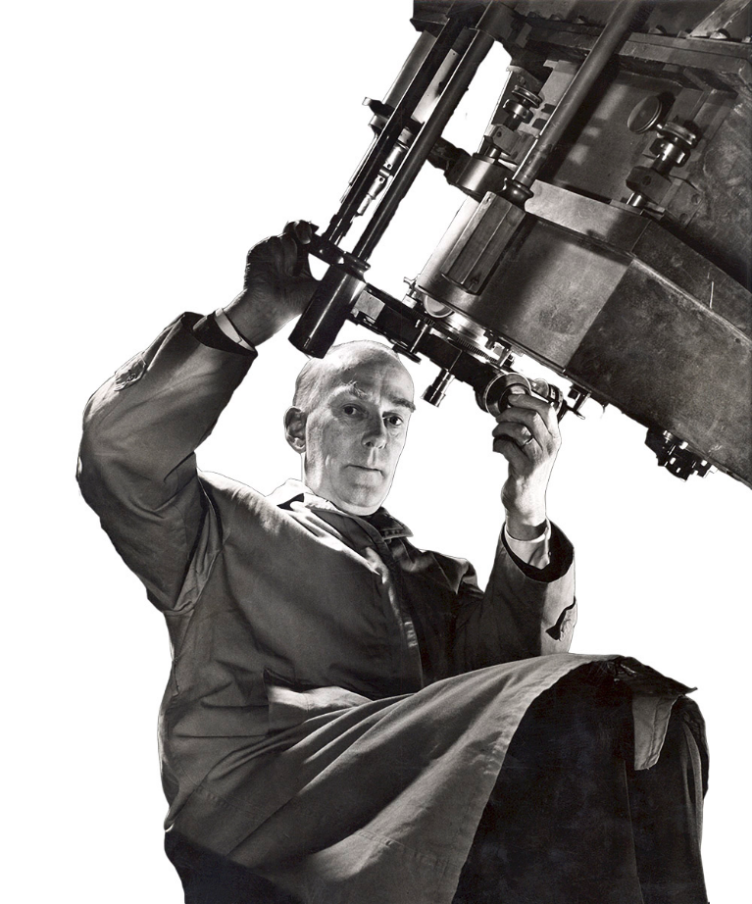
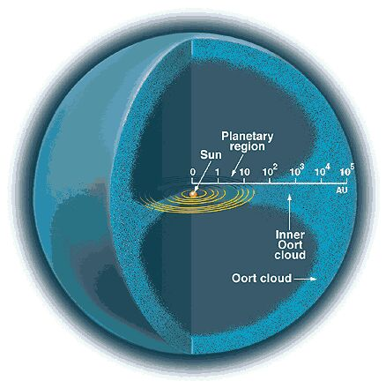
Jan Oort

