Slide 1
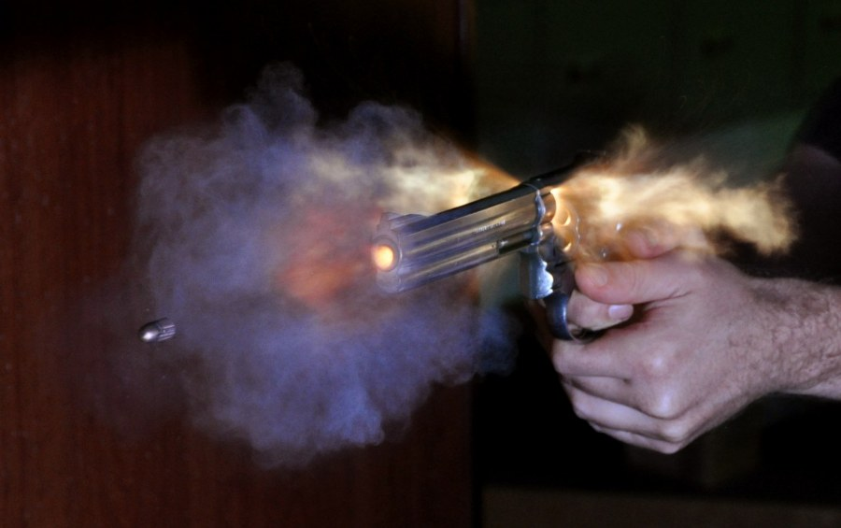
Ballistics

Slide 2
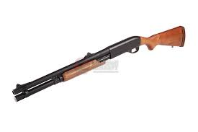
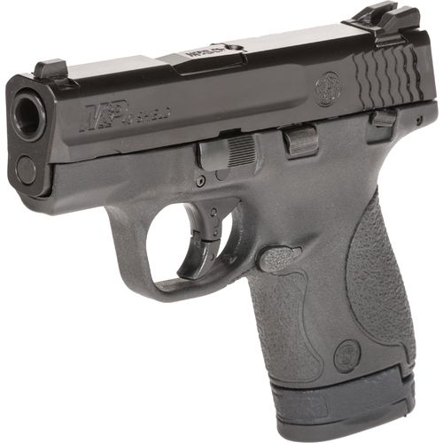
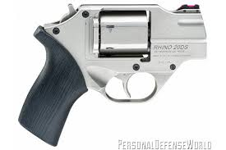
Introduction
Ballistics is the study of bullets and firearms.
Firearm – a weapon such as a gun, capable of firing a projectile using a confined space.
Types of firearms
Pistols Rifles Shotguns
Revolver semiautomatic

Slide 3
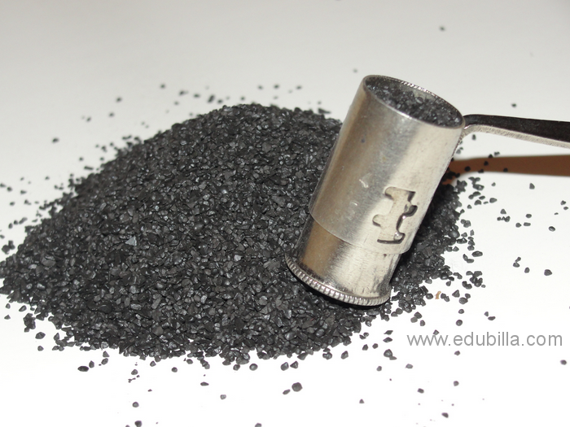
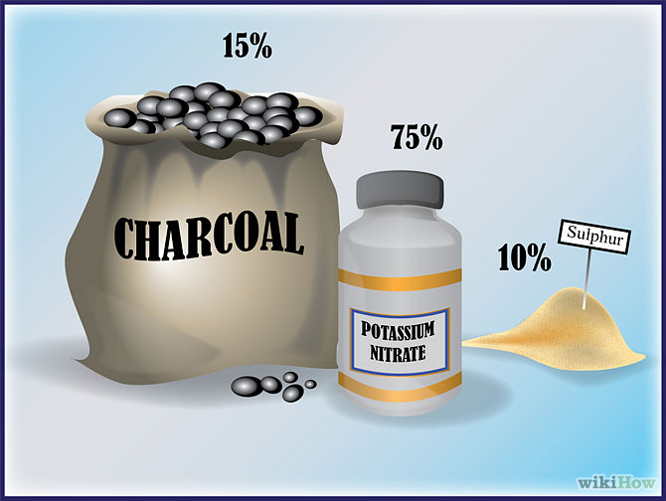
History
The Chinese invented gunpowder more than 1,000 years ago. They used it to make fireworks and shoot balls of flaming materials at their enemies.
Gunpowder is a mix of potassium nitrate (aka saltpeter), charcoal and sulfur. When ignited it expands to six times its original size, causing a violent explosion (if contained).

Slide 4
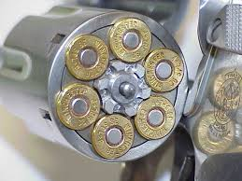
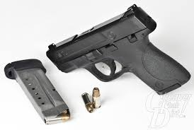
Handguns
Handguns fired with one hand are called pistols. American inventor Samuel Colt developed and patented a model in 1835. It had a cylinder that rotated and could be loaded with several cartridges and fired in rapid succession.
Revolver – a pistol that has a cylinder that
turns as it is fired.
Semiautomatic – a pistol that has a magazine (clip)
that holds multiple cartridges. The weapon ejects the
used cartridge and advances another when the trigger
is pulled multiple times.

Slide 5
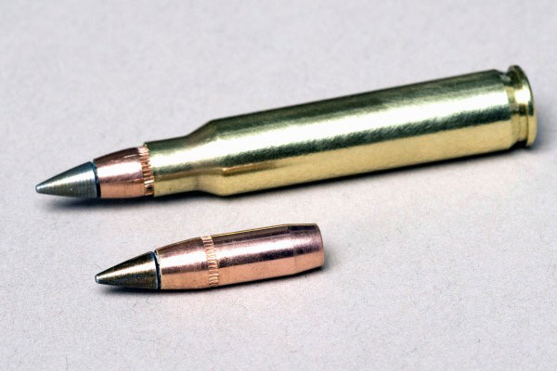
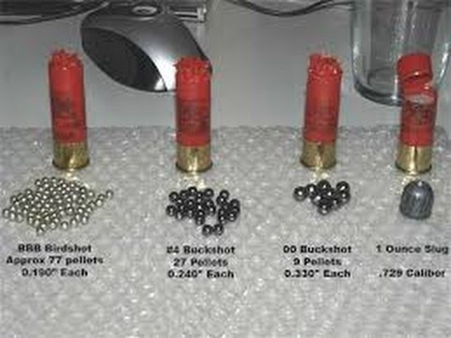
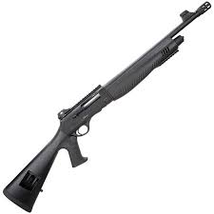
Long Guns
Long guns typically require two hands for accuracy.
Rifles – long guns that fire bullets
Shotguns – long guns that can fire single projectiles (slug) or small round pellets (shot)

Slide 6
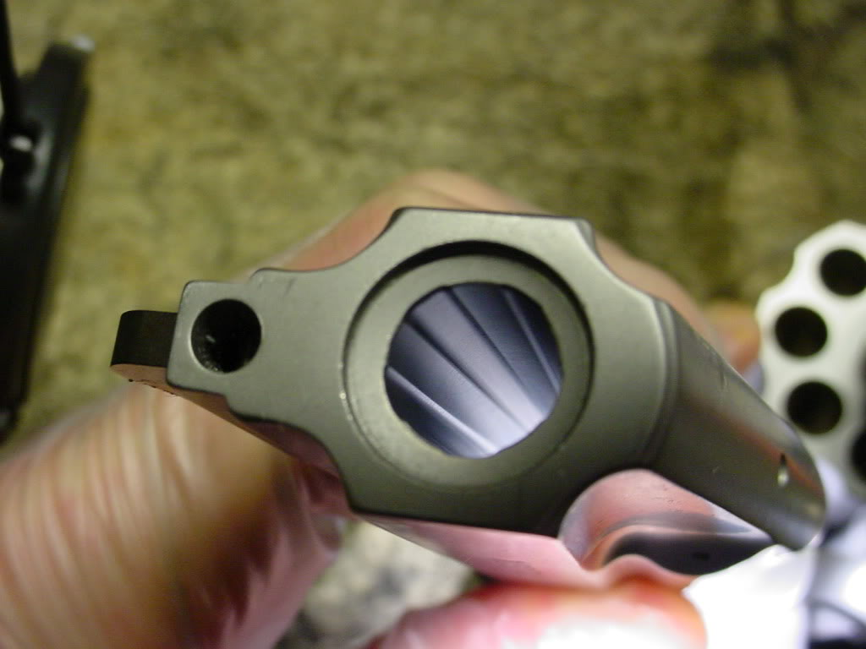
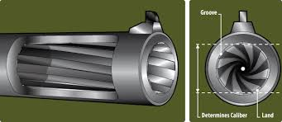
Rifling
To improve accuracy a bullet must twist as it is projected. This is similar to the spiral in a well thrown football. The grooves that spiral down the barrel of a rifle or pistol create a raised area called lands. This pattern is called rifling and it differs from one manufacturer to another.

Slide 7
Cartridges

Slide 8
How a firearm works
https://www.youtube.com/watch?v=rJMXXuGhINE

Slide 10
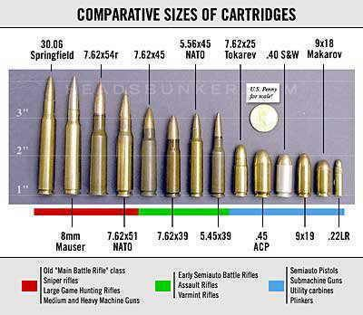
Caliber
Caliber is a measure of the diameter of a cartridge. While many are measured in hundredths of an inch (ex: .22, .357, .38, .45), 9mm and 10mm weapons are becoming more common.

Slide 11
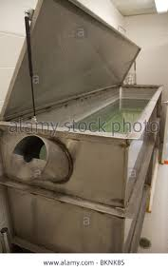
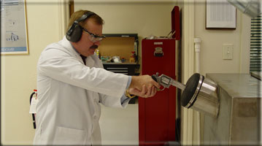
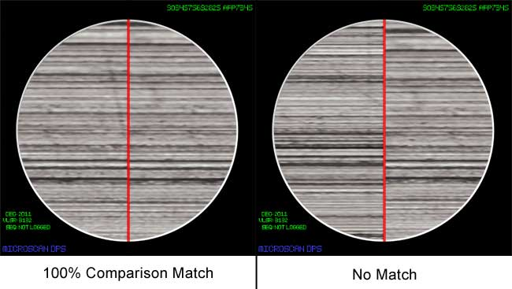
Bullets and Cartridge Casings
Are scratched by the lands of the barrel as they proceed down the weapon. A bullet that has hit soft material may show these marks, called striations on them. A weapon test fired into a water tank will yield an undamaged round allowing for comparison
.

Slide 12
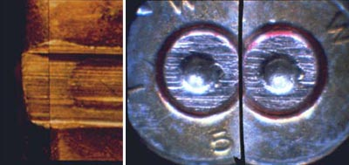
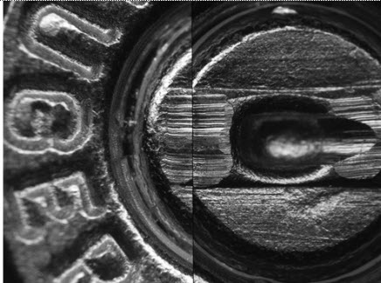
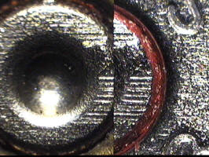
Marks from the firing pin, breech face, extractor and ejector may also be found on the spent casing.

Slide 13
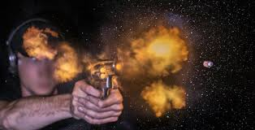
Gunshot Residue
GSR – tiny particles of primer and unburned powder that are expelled from the front and back of the firearm pushed by the expansion of gases when the bullet is fired.

Slide 14
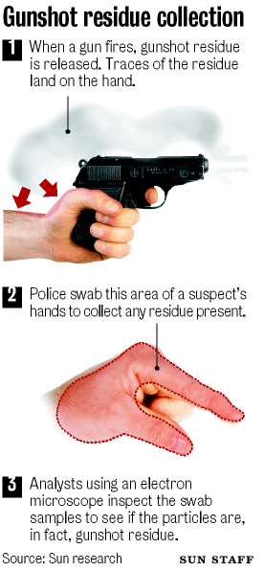
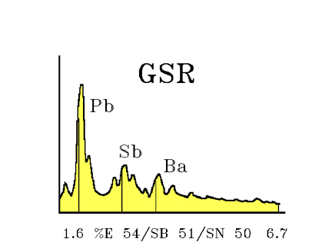
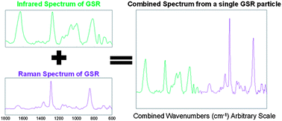
Testing for GSR
Primer residues include heavy metals such as barium, antimony and lead.
Unburned nitrates from the gunpowder may also be present.

Slide 15
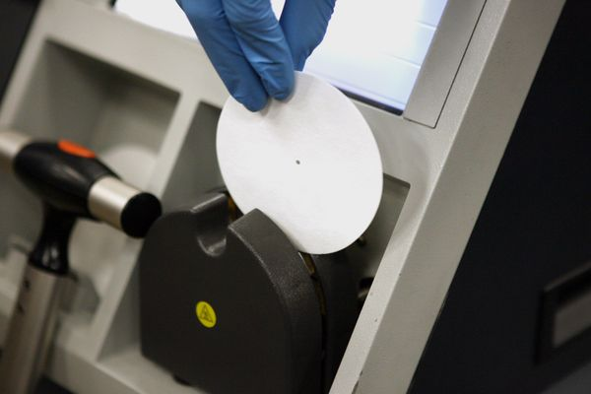
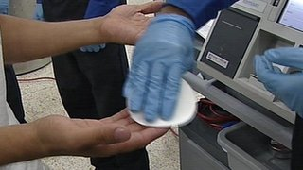
TSA Testing

Slide 16
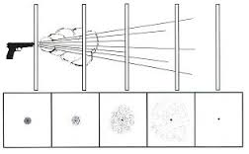
Distance Determination
Distance Determination – The process of determining the distance between the firearm and a target, usually based on the distribution of powder patterns or the spread of a shot pattern.

Slide 18
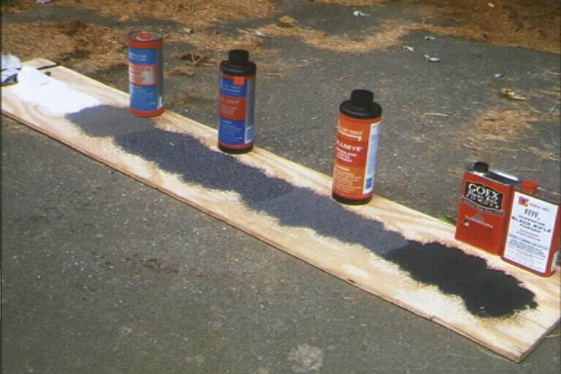
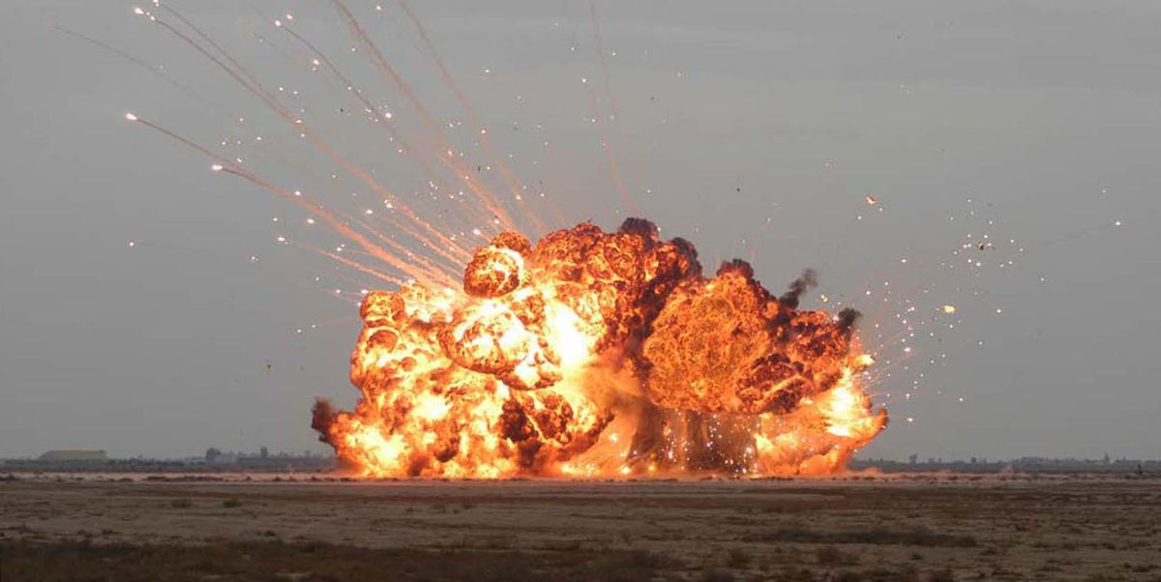
Types of Explosives
Explosion – a chemical or mechanical action resulting in the rapid expansion of gases.
The speed at which explosives decompose varies greatly from one to another and permits their classification as high and low explosives.

Slide 19
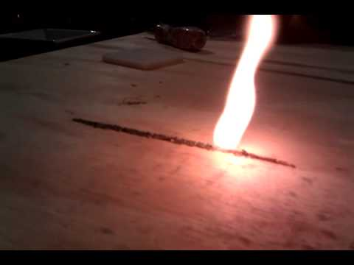
Low explosive – explosive with a velocity of detonation less than 1,000 meters per second. For example, black powder and smokeless powder.
In the low explosive the speed is called speed of deflagration (burning). This is characterized by a very rapid oxidation producing heat, light and a subsonic pressure wave.

Slide 20
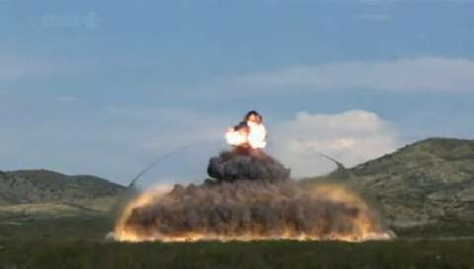
High Explosive – Explosive with a velocity of detonation greater than 1,000 meters per second. For example, dynamite and RDX.
In the high explosive, the speed is called the speed of detonation. Detonation – refers to the creation of a supersonic shock wave within the explosive charge.
This shock wave causes the chemical bonds of the explosive charge to break apart, leading to the new instantaneous buildup of heat and gases.

Slide 21
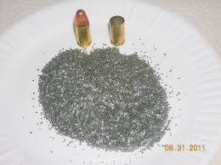
The most widely used low explosives are black powder and smokeless powder.
Black powder is a relatively stable mixture of potassium or sodium nitrate, charcoal, and sulfur. Unconfined, it merely burns. It becomes explosive and lethal when confined.
Safety fuses usually consist of black powder wrapped in a fabric or plastic casing.
The safest and most powerful low explosive is smokeless powder.

Slide 22
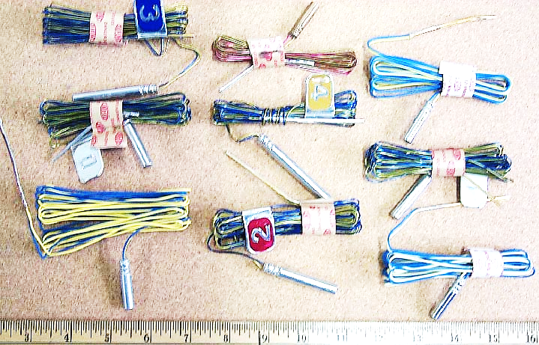
High explosives are classified into two groups by their sensitivity.
Primary explosives – a high explosive easily detonated by heat or shock.
Usually used to detonate other explosives through a chain reaction and are referred to as primers.
Often found in blasting caps.

Slide 23
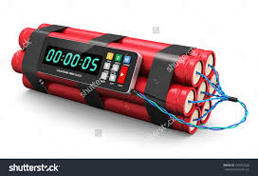
Secondary explosives – are relatively insensitive to heat, shock, or friction, and will normally burn rather than detonate if they are ignited in small quantities in the open air. C-4 burn c-4 explode
Includes dynamite, TNT (trinitrotoluene), PETN (pentaerythritol tetranitrate), RDX (cyclotrimethylenetrinitramine)

