Slide 1
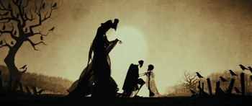
Time of Death

Slide 2
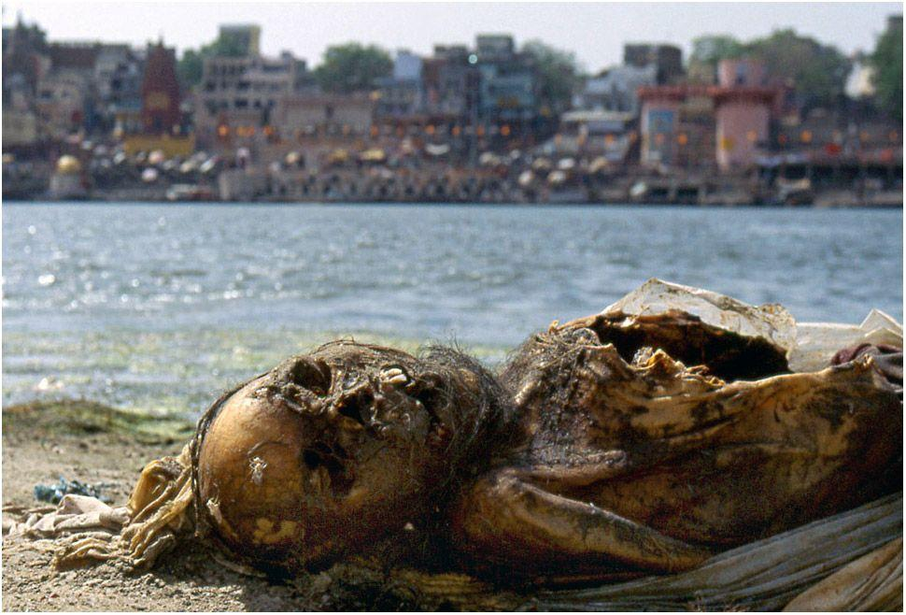
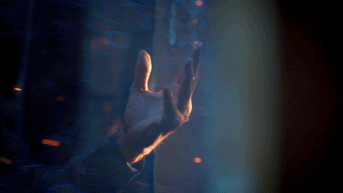
Importance of TOD
1st question at most murder scenes: "How long has this person been dead?“
It's crucial to know when the crime was committed.
it can help narrow the search for a suspect or
it can help rule out potential suspects who had alibis at the time the victim was killed.

Slide 3
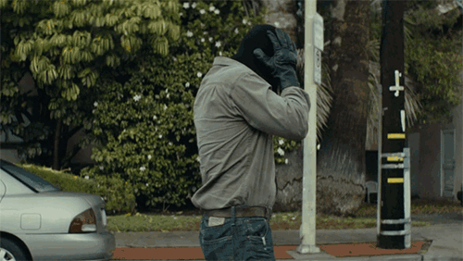
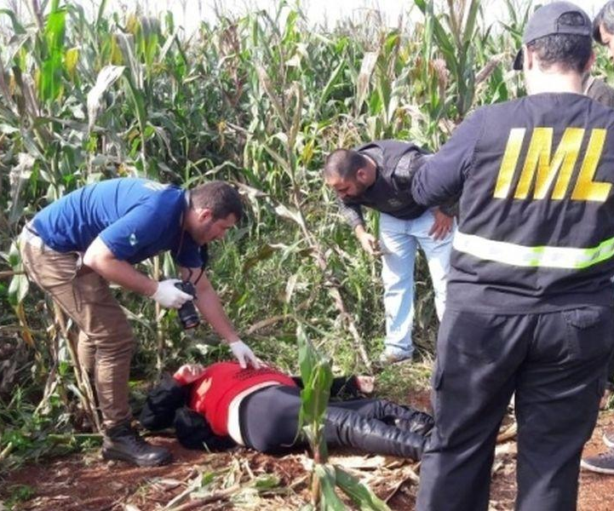
Postmortem Time Interval
The postmortem interval is the time since death (how long has this person been dead?)
What Time Did the Person Die?
Best estimate; offered with a reasonable degree of medical and scientific certainty.
Impossible to be 100% accurate.
UNLESS a witness (who doesn’t lie) is present at the time of death, it generally is an estimate of time (2-4 hour window is the usual).

Slide 4
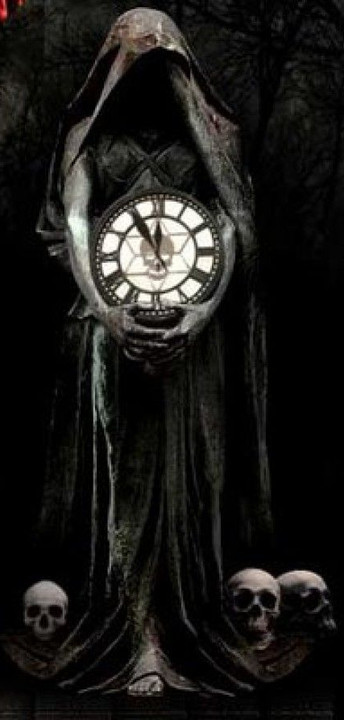
Estimating Time of Death
Rigor mortis
Livor mortis: (Lividity)
Algor mortis: Body Core Temperature
Potassium levels + Clouding of the cornea
Stomach Contents
Evidence of Decomposition Process
Presence/absence of purge fluids
Drying of the tissue
Insect Larval Instars

Slide 5
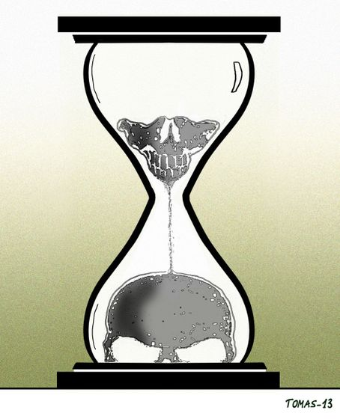
Algor Mortis
Uses body temperature to determine time of death
Normal body temperature is 98.6⁰F
A body loses heat at a rate of 1.4⁰C per hour until the ambient temperature is reached
Rate varies according to environmental temperature
Once ambient temperature is reached, you cannot use this method to determine time of death ~24 hours

Slide 6
TOD Temp Calculations
Normal body temperature is 98.6⁰F
Loss of body temperature at rate of 1.4 ⁰F/hour for the first 12 hours
After the first 12 hours at a rate of 0.7 ⁰F/hour

Slide 7
Factors affecting Algor Mortis
Factors affecting Algor mortis | Event | Effect | Circumstances
Temperature | Cold | Accelerate | Lose heat faster
 | Warm | Slows | Lose heat slower
Wind | Windy | Accelerate | Faster heat loss
 | Calm | Slows | Slower heat loss
Body fat | Obese | Slows | Slow down heat loss
 | Thin | Accelerate | Speed up heat loss
Clothing | Clothed | Slows | Slow down heat loss
 | Naked | Accelerate | Speed up heat loss

Slide 8
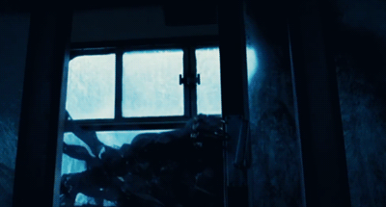
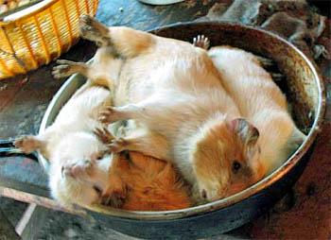
Rigor mortis
The medical condition that occurs after death
Results in the shortening of muscle tissue and the stiffening of body parts
Body stays in the position they are in when death occurs
Begins within 12 hours and ends after 48 hours:
After 48 hours, muscle cells begin to autolyze

Slide 9
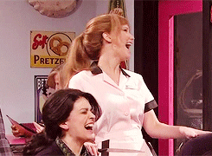
Rigor Mortis Timeline
1-4 hours: Jaw and neck rigid, rest of body limp
At ~8 hours: everything down to the legs is rigid
At ~12 hours: everything remains rigid
24 hours: Jaw is limp, everything else is rigid
30-32 hours: everything but the legs are limp
36 hours: entire body is limp (no rigidity) decomposition has begun

Slide 10
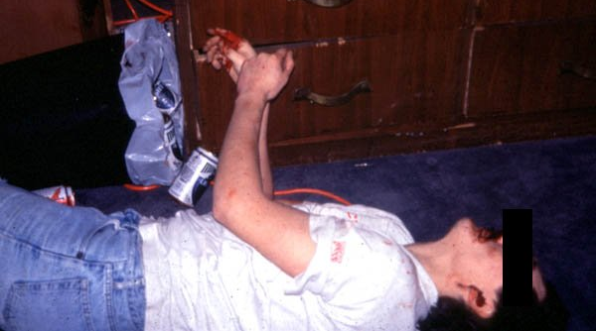
Rigor Mortis

Slide 11
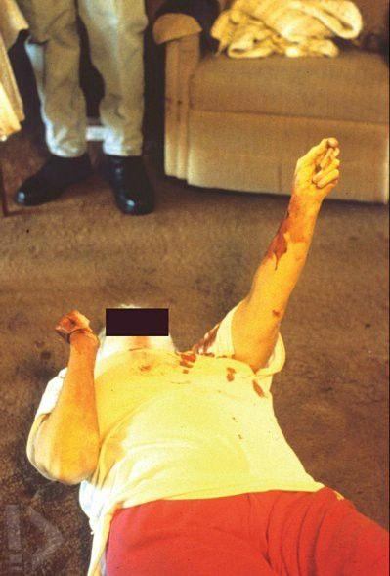
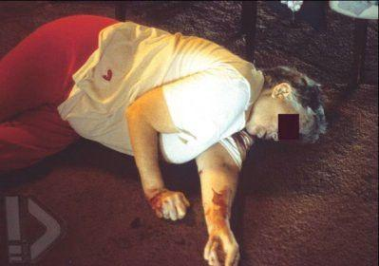

Slide 12
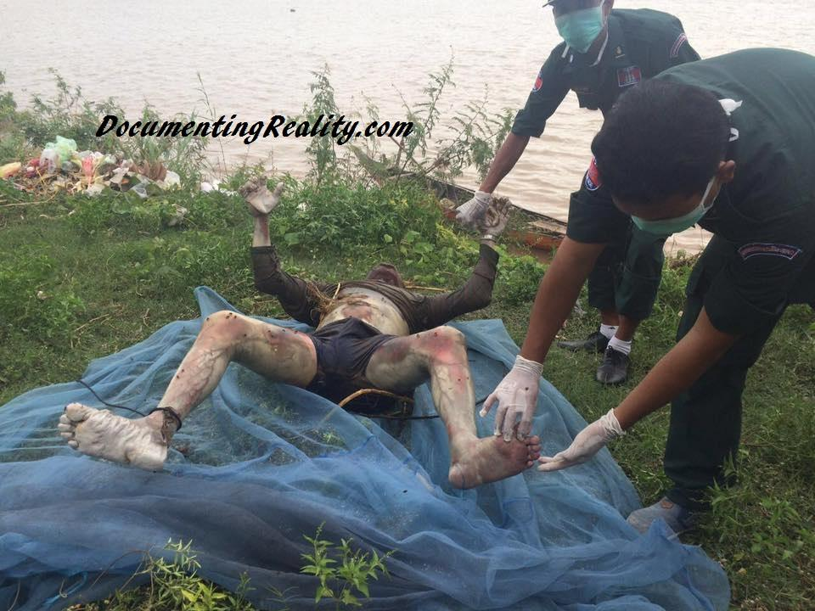

Slide 13
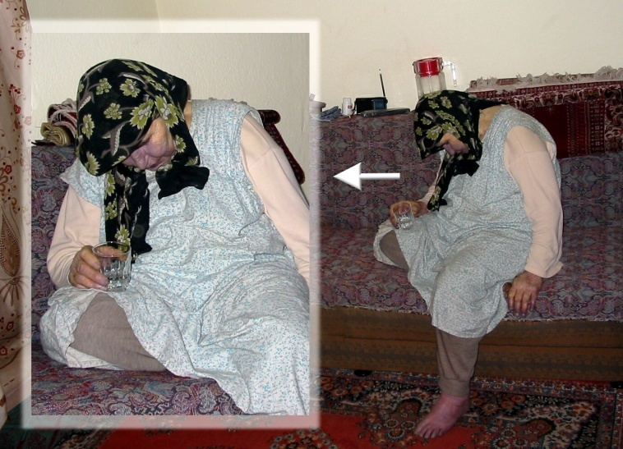

Slide 14
Factors affecting Rigor Mortis
Factors affecting Rigor mortis | Event | Effect | Circumstances
Temperature | Warm | Accelerate | Slower onset
 | Cold | Slows | Faster onset
Activity Before Death | Anaerobic Exercise | Accelerate | Buildup of lactic acid and heat; accelerates rigor
 | Sleep | Slows | Fully oxygenated muscles slow down rigor
Body fat | Obese | Slows | Fat stores oxygen
 | Thin | Accelerate | Body loses more oxygen

Slide 15
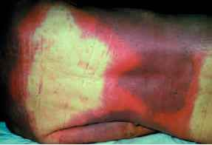
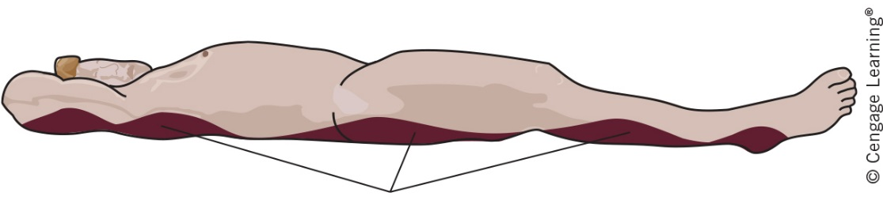
Livor mortis
Pooling or settling of blood in tissues after death
Begins 2 hours after death becomes permanent after 8
Livor mortis can Determine Time of Death
Within 2-8 hours, can press skin and color disappears
Blanching
Thumb pressure indicates that the lividity is not fully fixed
Reveal the position of the corpse within first 8 hours
If on back, blood will pool along backside
Reveal if the body was moved

Slide 16
Blanching

Slide 17
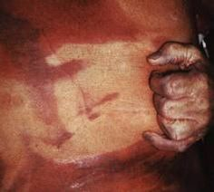
Livor Mortis

Slide 18
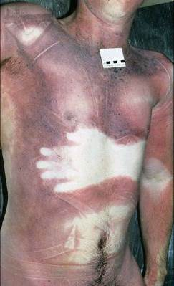
Livor Mortis

Slide 19
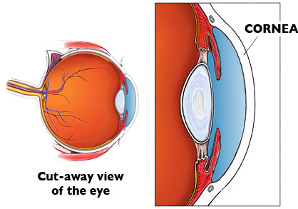
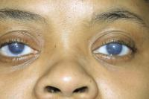
Clouding of the Cornea
Cornea is the clear covering of your eyes
Becomes cloudy and opaque after death
Takes only 2 hours after death if eyes are open at death
It takes 24 hours if eyes are closed at death

Slide 20
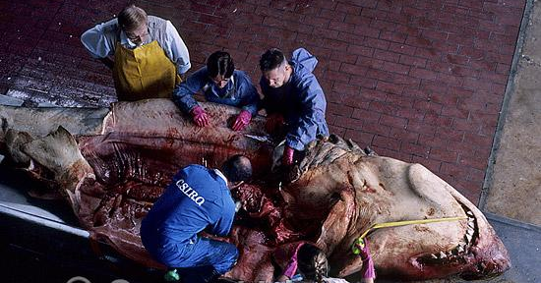
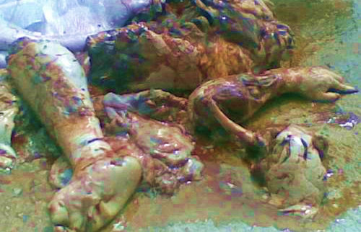
Stomach Contents
Food flows from stomach to small intestine to large intestine before leaving the body
If there is undigested food in the stomach, death occurred 0 to 2 hours after the meal
If there is undigested food in the small intestine but not stomach, death occurred 4 to 6 hours after meal
If there is food in the large intestine but not the small intestine or stomach, death occurred 12+ hours

Slide 21
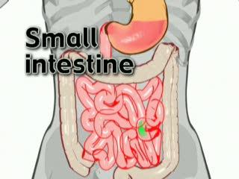
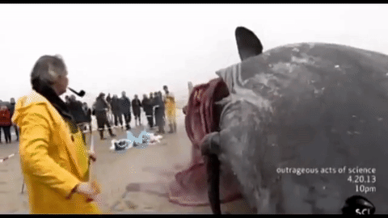
Food Contents Example
Example –
Determine the time of death from the last meal if food is found in the small intestine
Answer: Death occurred 4 - 6 hours after the last meal

Slide 22
Summary of Factors
PROMOTING DECAY
DELAYING DECAY
Oxygen supply not restricted
Warm temperature (15-37°C)
Humid atmosphere
Presence of invertebrate detritivores (e.g. blowfly larvae)
Wasp, ant and other invertebrate predators feeding on corpse
Wounds permitting invertebrates easier access to internal body tissues
Surface burning causing skin to crack and thereby allowing easier access of invertebrates and oxygen to internal tissues
Obesity
Suffering from septicemia or myiasis before death
Body exposed to the environment above ground
Body resting on soil
Oxygen supply restricted
Cold temperature (<10°C; decay will cease below 0°C)
Dry atmosphere
Absence of invertebrate detritivores
Wasp, ant and other invertebrate predator feeding on detritivores
Inability of detritivores to gain access to all or part of the corpse
Intense burning resulting in tissues becoming carbonized and drying out.
Burial on land or underwater (rate of decay declines with increasing depth)
Body suspended above ground (e.g. hanging)
Formation of adipocere
Mummification
Embalming

