Slide 1
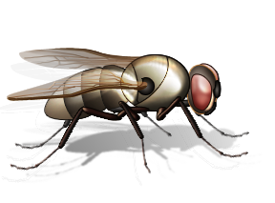
Forensic Entomology
Insects as Evidence
Warning: Some material in this presentation and related videos may be too graphic for some people.
T. Trimpe 2009 http://sciencespot.net/

Slide 2
What do they do?
Forensic entomologists apply their knowledge of entomology to provide information for criminal investigations.
A forensic entomologist’s job may include:
Identification of insects at various stages of their life cycle, such as eggs, larva, and adults.
Collection and preservation of insects as evidence.
Determining an estimate for the postmortem interval or PMI (the time between death and the discovery of the body) using factors such as insect evidence, weather conditions, location and condition of the body, etc.
Testifying in court to explain insect-related evidence found at a crime scene.
Did you know? Maggots can be used to test a corpse for the presence of poisons or drugs. Some drugs can speed up or slow down the insect’s development.
Cool Jobs: Forensic Entomology
Discovery Video

Slide 3
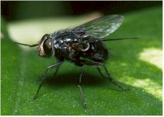
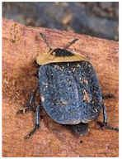
Insects as Evidence
Forensic entomologists use their knowledge of insects and their life cycles and behaviors to give them clues about a crime.
Most insects used in investigations are in two major orders:
1 – Flies (Diptera) and
2 – Beetles (Coleoptera)
Blow Fly
Carrion Beetle
Species succession may also provide clues for investigators. Some species may to feed on a fresh corpse, while another species may prefer to feed on one that has been dead for two weeks. Investigators will also find other insect species that prey on the insects feeding on the corpse.
Images: Top Right - http://www.insectinvestigations.com/aboutfe.htm, Chart - http://www.clt.uwa.edu.au/__data/page/112507/fse07_forensic_entomology.pdf

Slide 4
Weather data is also an important tool in analyzing insect evidence from a corpse. Investigators will make note of the temperature of the air, ground surface, the interface area between the body and the ground, and the soil under the body as well as the temperature inside any maggot masses. They will also collect weather data related to daily temperature (highs/lows) and precipitation for a period of time before the body was discovered to the time the insect evidence was collected.
Other factors that might affect their PMI estimates:
Was the body enclosed in an area or wrapped in a material that would have prevented flies from finding the corpse and laying eggs?
Were other insect species present that may have affected the development of the collected species?
Were there drugs or other poisons in or on the body that might have affected the larvae’s development?
Did you know…
The “Body Farm” in Knoxville, Tennessee is a university research facility to investigate human decomposition under various conditions in order to understand the factors which affect its rate.
Click the image to view a video about the Body Farm!

Slide 5
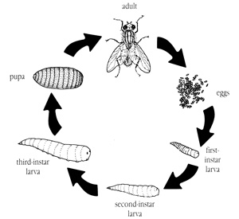
Blow Fly Metamorphosis
Blow flies are attracted to dead bodies and often arrive within minutes of the death of an animal. They have a complete life cycle that consists of egg, larva, pupa, and adult stages.
1st – Adult flies lay eggs on the carcass especially at wound areas or around the openings in the body such as the nose, eyes, ears, anus, etc.
2nd – Eggs hatch into larva (maggots) in 12-24 hours.
3rd– Larvae continue to grow and molt (shed their exoskeletons) as they pass through the various instar stages.
1st Instar - 5 mm long after 1.8 days
2nd Instar - 10 mm long after 2.5 days
3rd Instar – 14-16 mm long after 4-5 days
4th – The larvae (17 mm) develop into pupa after burrowing in surrounding soil.
5th – Adult flies emerge from pupa cases after 6-8 days.
Adult
Pupa
Eggs
3rd Instar Larva
1st Instar Larva
2nd Instar Larva
It takes approximately 14-16 days from egg to adult depending on the temperatures and humidity levels at the location of the body.
Image: http://www.umext.maine.edu/images/FlyLife.jpg
Information: http://www.kathyreichs.com/entomology.htm and http://www.forensicentomologist.org/

Slide 6
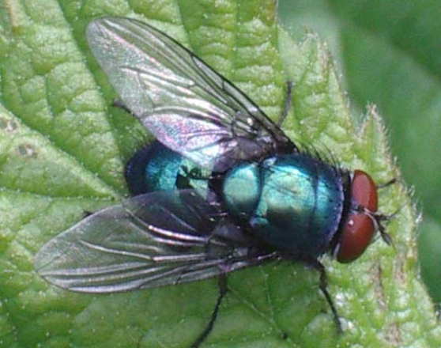
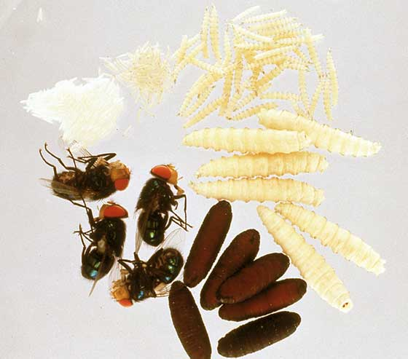
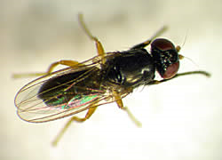
Examples of Diptera (Flies)
Early Stage Decomposition
Blow & Greenbottle Flies
(Calliphoridae)
Metallic thorax and abdomen
Flesh Fly
(Sarcophagidae) Striped thorax
Life Cycle of a Calliphoridae Fly
Late Stage Decomposition
House Fly
(Muscidae)
Cheese Skipper
(Piophilidae)
Informational Source: http://naturalsciences.org/files/documents/csi_tg_overview.doc Images: Top Left - http://www.scienceinschool.org/repository/images/issue2forensic3_large.jpg, Middle-Left: http://forensicfact.files.wordpress.com/2008/04/blowfly053.jpg, Top Right - http://users.usachoice.net/~swb/forensics/P1.jpg, Bottom - http://www.deathonline.net/decomposition/corpse_fauna/flies/index.htm

Slide 7
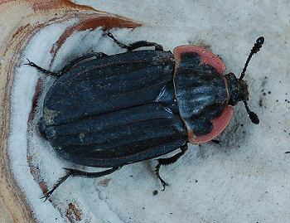
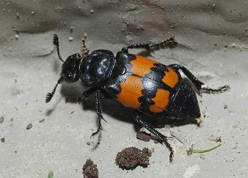
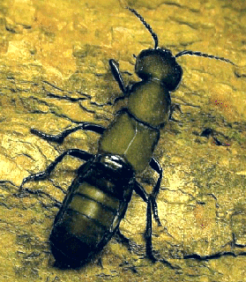
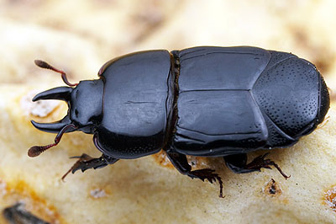
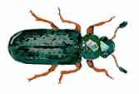
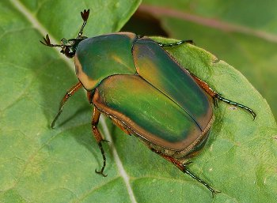
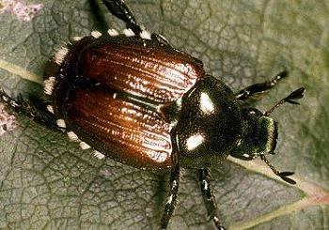
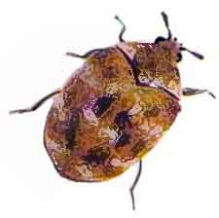
Examples of Coleoptera (Beetles)
Early Stage Decomposition
Early to Late Stage Decomposition
Carrion Beetles (Silphidae) Adults & larvae feed on fly larvae
Rove Beetles
(Staphylinidae)
Predator of fly eggs
Clown Beetles
(Histeridae)
Predator of fly eggs
Late Stage Decomposition
Ham & Checkered Beetles (Cleridae) Predator of flies & beetles;
also feed on dead tissue
Hide Beetles (Scarabidae) Usually the last to arrive
Skin Beetles (Dermestidae) Feed on dried skin & tissues
Informational Source: http://naturalsciences.org/files/documents/csi_tg_overview.doc
Images: http://www.cals.ncsu.edu/course/ent425/library/spotid/coleoptera/coleoptera.html & http://www.forensicflies.com/beetles.htm

