Slide 1
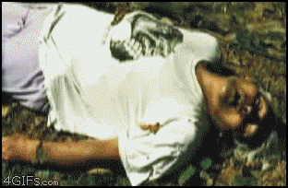
Death

Slide 2
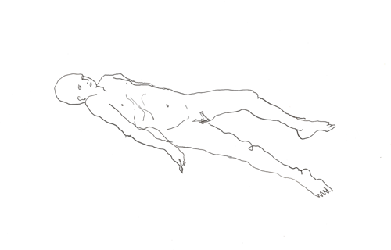
What is Death?
Death is a process and not a singular event. At the time of death, the following processes occur from seconds to hours later:
Heart stops beating, breathing ceases
Oxygen is no longer circulated throughout the body via the bloodstream
Brain dies within 3-7 minutes without oxygen (almost always irreversible)
All other cells & organs begin to die off (up to 15 hours to donate)
Autolysis occurs (cells broken down by their own enzymes)
Muscles relax; bladder and bowels release

Slide 3
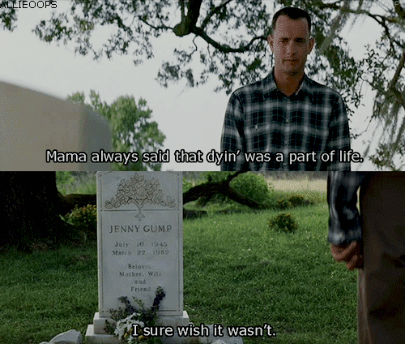
Attended Deaths
If you die at the hospital or hospice care, a physician will sign off on a medical certificate on cause of death
If COD is unknown, the person may go off for an autopsy or the family can request a private one (approximate cost $3,000)
After autopsy, the body is returned to the custody of the family via transportation to a funeral home
The body is either embalmed or cremated according to the person’s wishes; decomposition does NOT occur

Slide 4
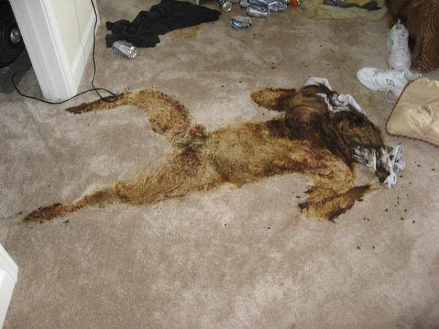
Unattended Deaths
Anytime a person dies unexpectedly or alone, the police will open up an investigation and treat it like a potential homicide
Autopsies will be performed for all unattended deaths except in the case of elderly people, as its up to the coroner since its more likely to be natural causes
In some cases it may take hours, days, months, years to find their body
Investigators will need to know the stages of decomposition to determine time, cause and manner of death

Slide 7
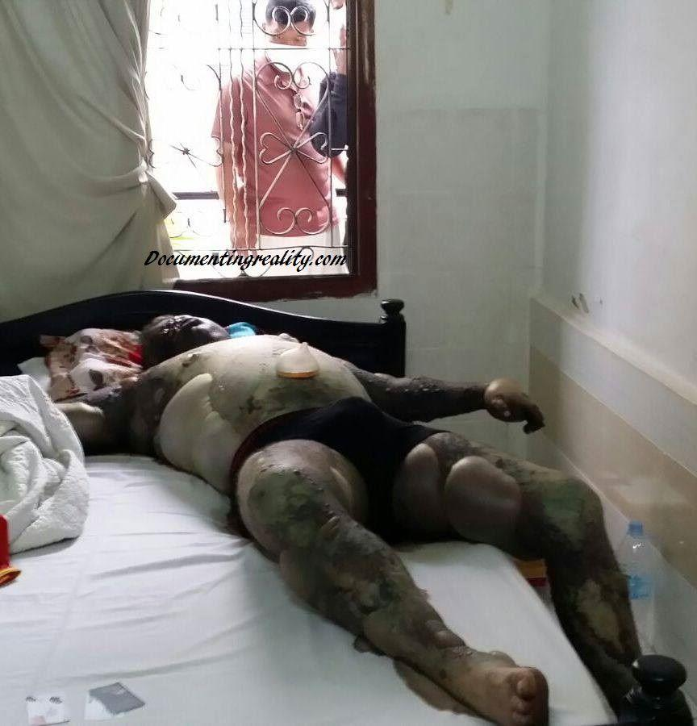
Decomposition
The disintegration of body tissues after death
Tissue components leak and release hydrolytic enzymes
Bacteria and other microorganisms thrive on the organic material of the body
Two parallel process of decomposition occur:
Autolysis: Self-dissolution by body enzymes released from disintegrating cells
Putrefaction: Decomposition changes produced by the action of bacteria and microorganisms

Slide 8
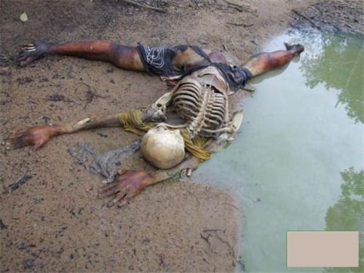
Putrefaction
The normal final sign of death
Starts immediately after death at the cellular level
Breakdown of protein and liquefaction of the body
Becomes visible in 48-72 hours
Its onset may be sped up or delayed by several factors mainly:
Temperature
The ambient temperature can speed up or slow down this process
A fever prior to death can speed up putrefaction
Humidity
One week in air equals two weeks in water and eight weeks in soil

Slide 9
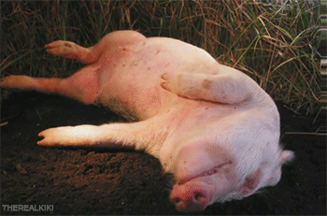
5 Stages of Decomposition
1) Initial Decay (0-3 days)
2) Putrefaction (4-10 days)
3) Black Putrefaction (10-20 days)
4) Butyric Fermentation (20-50 days)
5) Dry Decay (50+ days)

Slide 10
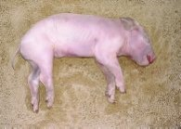
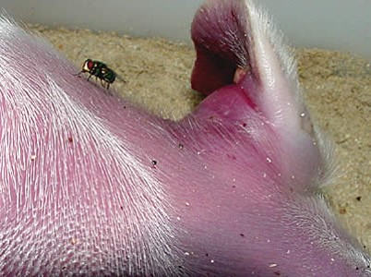
Initial Decay
Days 0-3
Corpse appears normal on the outside but body is breaking down due to autolysis
Flies land and lay eggs, which hatch into maggots*
After 24 hours, the face is harder to recognize
The abdomen becomes blue-green after 3 days
Rodents and pet cats can eat the face of the body; dogs tend to guard the owner’s body

Slide 11
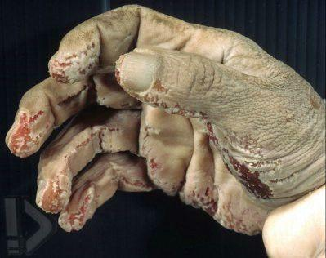
Initial Decay

Slide 12
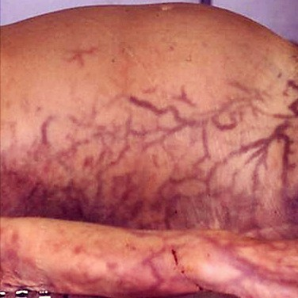
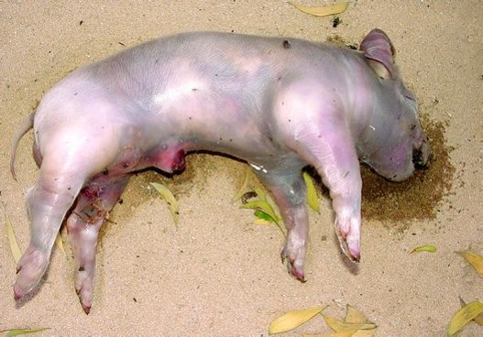
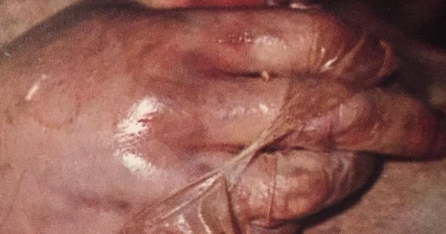
Putrefaction
Days 4-10
Corpse appears bloated and swollen
Days 5-6 the abdomen greatly swells and skin blisters
Skin is marble-colored and may be leaking fluids
Body begins to smell
Skin slips & hair and nails fall off at days 4-7

Slide 13
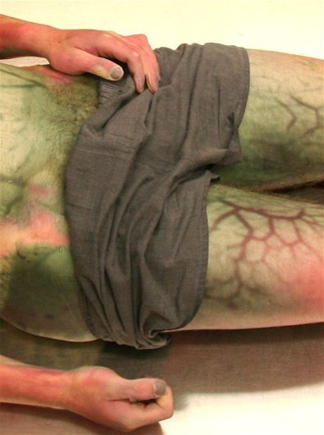
Putrefaction

Slide 14
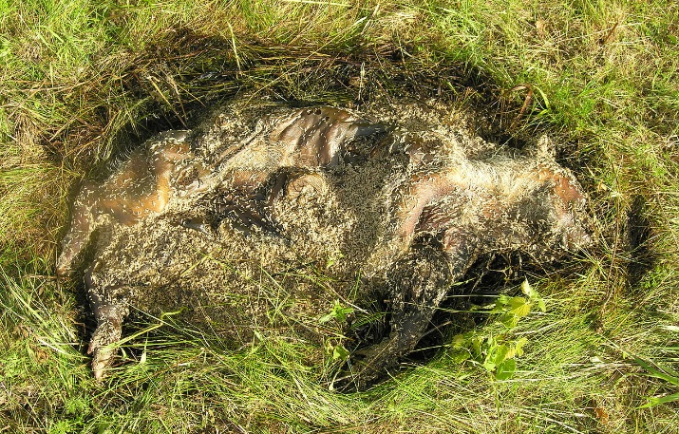
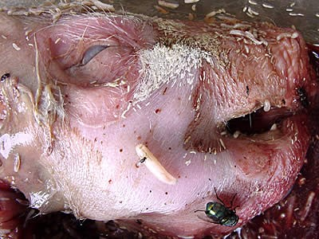
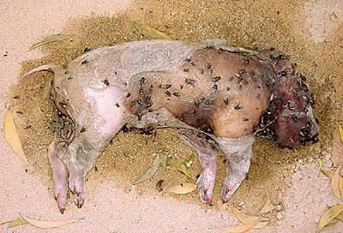
Active Decay
AKA Black Putrefaction
Days 10-20
Body has very strong odor
Flesh is black colored and skin has ruptured- seeping fluids and gases
Creates a cadaver of decomposition island (CDI)
Most of the body mass disappears due to insect activity- greatest amount of maggots at this time
Ends when maggots migrate away from the body to pupate

Slide 15
Active Decay

Slide 16
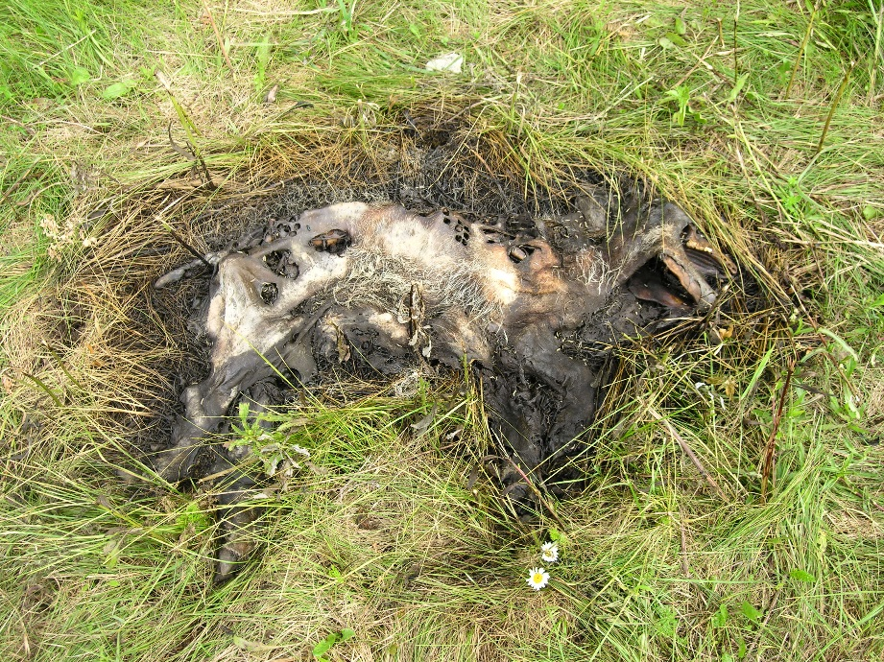
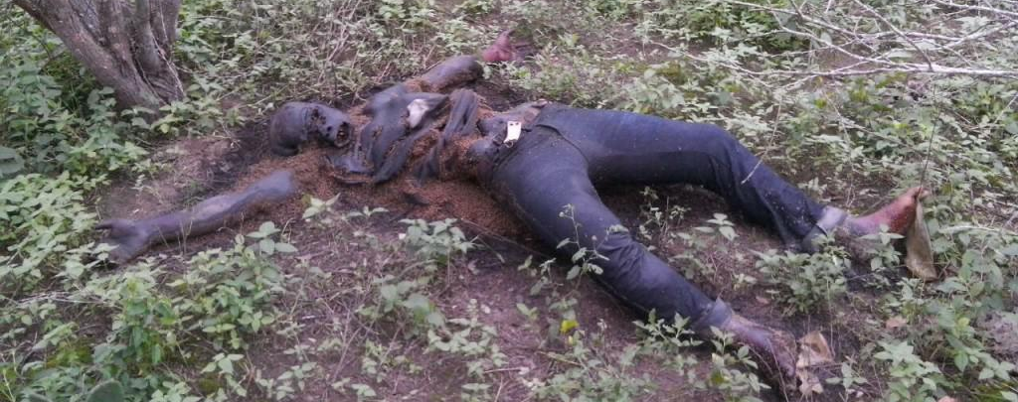
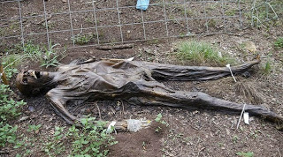
Advanced Decomposition
Aka Butryic Fermentation
Days 20-50
Post burst of all fluids
Body is drying out & most of the flesh is gone
Adipocere is forming- wax like substance from body fat

Slide 17
Adipocere

Slide 18
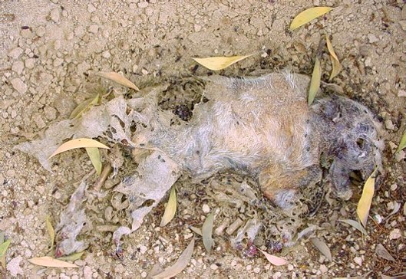
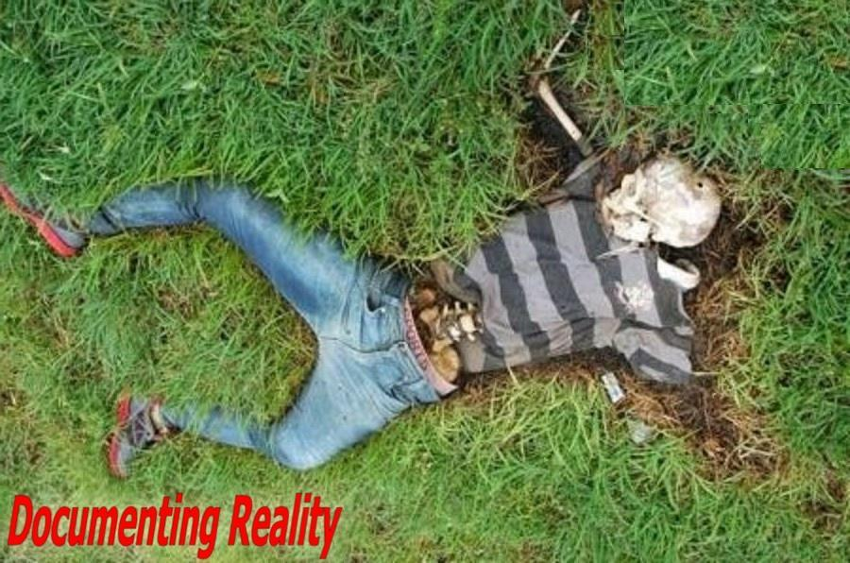
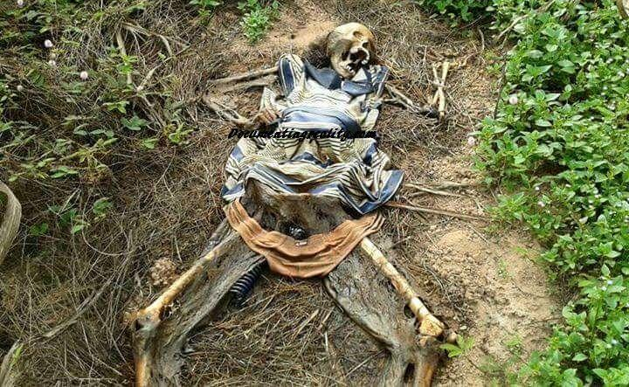
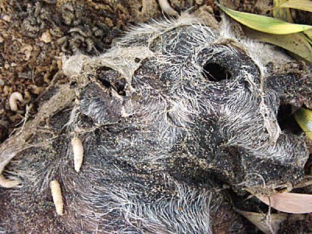
Dry Decay
Days 50+
Mostly skeletal remains, only bones, cartilage and dry skin
Vegetation starts to grow back

