Slide 1
Glass Evidence – Fracture Patterns
Unit 2B

Slide 5
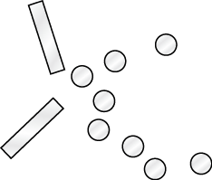
Fracture Patterns in Broken Glass
Glass has some flexibility.
When stretched too far, fracture lines appear and the glass may break.
Fracture patterns can provide clues about the direction and rate of impact.
Tension
Compression

Slide 6
Fractures
1st Radial Fractures
Start at the point of impact and radiate, move outward, from there.
Form on the side opposite the point of impact
2nd Concentric Fractures
Concentric circles that have the same center.
Form on the same side of the glass as the point of impact.

Slide 7
Why Radial & Concentric Fractures Form
On the side of impact, the glass surface is compressed (squeezed together)
The Opposite side stretches and is under tension.
Glass is weaker under tension than under compression so the opposite side fractures 1st. Then the concentric fractures occur on the side of impact.

Slide 8
Bullet Fractures
The direction of the bullet thru the glass is easily determined.
The bullet pushes some glass ahead of it as it passes thru, causing a cone shaped piece of glass to exit along with the bullet. This makes the exit hole is larger than the entrance hole.
If several shots are fired thru the same pane of glass, order of the shots can be determined from the fracture lines
The 1st set of fractures set the boundary for further fracturing by following shots

Slide 9
Bullet Fractures
Single Shot
Multiple Shots

Slide 10
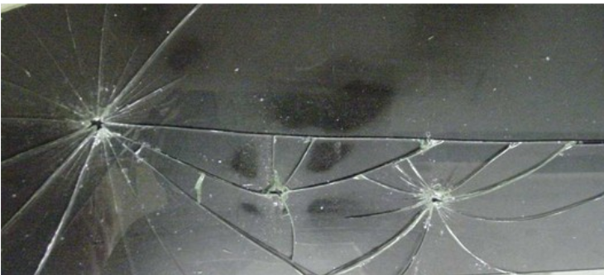

Slide 11
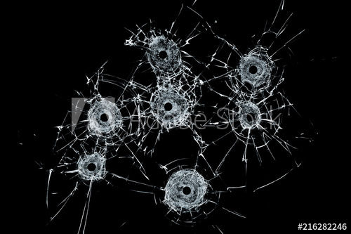

Slide 12
Path of Bullet Passing Through Window Glass
The angle at which the bullet enters the glass can help locate the location of the shooter
If bullet is fired perpendicular to the window, a round entry hole is seen.
Fired from an angle coming from the left? Glass pieces are forced out to the right, creating an irregular oval as it exits right.
Fired from the right? Irregular oval to the left.
Ammunition type can also be determined from the size and characteristics of the bullet hole.
Although, high speed bullets fired from a great distance can mimic the characteristics of a slower speed bullet at close range.

Slide 13
Backscatter
When a piece of glass breaks, most of the pieces fly forward BUT
Some can be projected backward, known as backscatter.
Occurs as glass pieces collide and tumble in various directions
Form of trace evidence

Slide 14
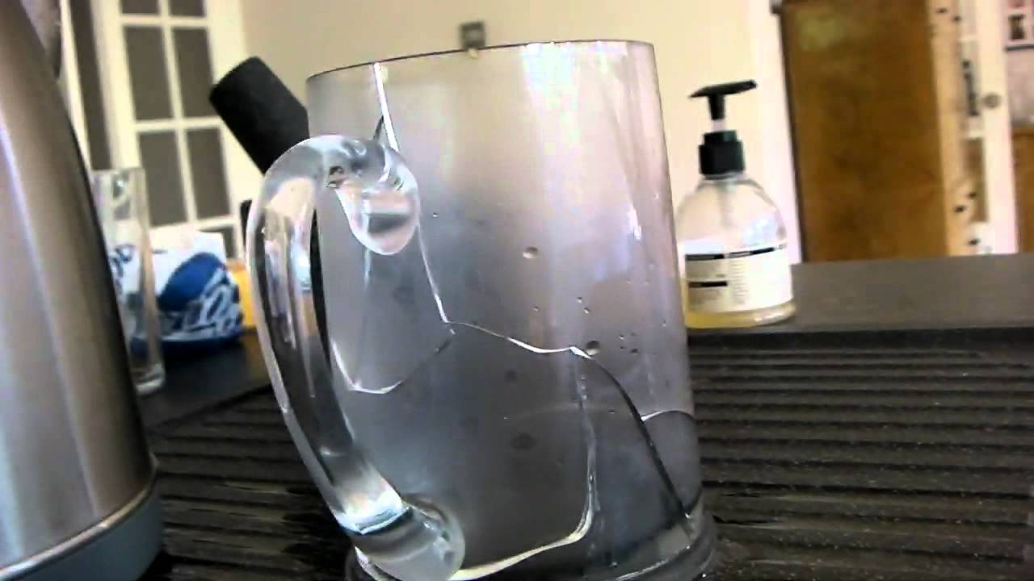
Heat Fractures
During a fire, glass can break as a result of heat fracturing
Produces breakage patterns on glass that are different from breakage patterns caused by impacts
Wavy fracture lines develop.

Slide 15
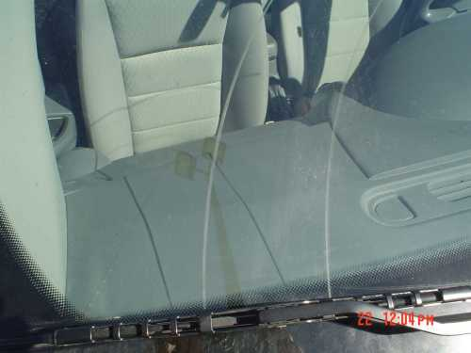
Other Scratch Patterns
Windshield wipers can leave marks on glass
Dirt or other particles can scratch glass as a window is rolled up or down repeatedly

