Slide 1
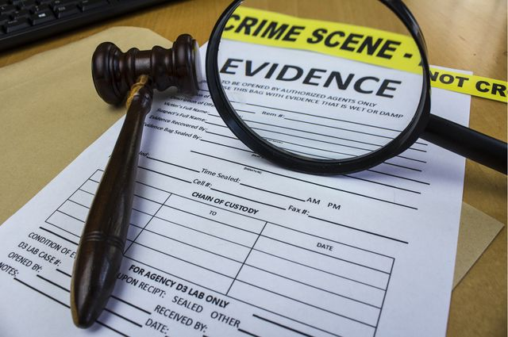
What’s Wrong with this Evidence Activity

Slide 2
Example

Slide 3
Evidence 1 Hair

Slide 4
Evidence 2 - Fibers

Slide 5
Evidence 3 – Red stained fabric

Slide 6
Evidence 4 – Soda can

Slide 7
Evidence 5 – Glass pieces

Slide 8
Evidence 6 – Cartridge Casing

Slide 9
Evidence 7 – Crystalline Substance

Slide 10
Evidence 8 – Cartridge Casings

Slide 11
Evidence 9 - Fibers

Slide 12
Evidence 10 - Hair

Slide 13
Evidence 11 - Fibers

Slide 14
Evidence 12 - Red stained fabric

Slide 15
Evidence 13 – glass pieces

Slide 16
Evidence 14 – Soda can

Slide 17
Evidence 15 – Crystalline substance

