Slide 1
Introduction to Forensic Science
Unit 1

Slide 2
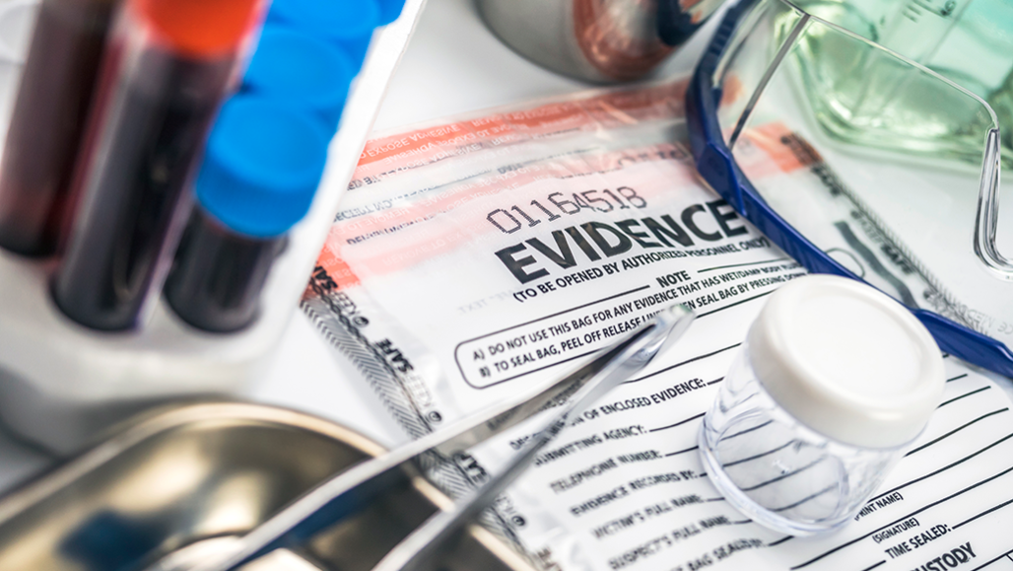
What is forensic science?
Broadest definition – it is the application of science to law
Better definition – the application of science to those criminal and civil laws that are enforced by police agencies in a criminal justice system.

Slide 3
Where it all started – a history
Earliest record of applying forensic science to solve a crime
3rd century China
A coroner solved a murder of a man whose wife claimed that he died in an accidental fire
Coroner noticed that there were no ashes from the fire in the dead man’s mouth.
Coroner experimented: He burned 2 pigs, 1 alive and 1 dead. Then he checked their mouths for ashes. The already deceased pig had no ashes in his mouth. The pig that was burned alive did have ashes in his mouth that he had breathed in before dying.
Coroner confronts the wife, she admitted her guilt.

Slide 4
Anthropometry
Developed by Alphonse Bertillon in 1879.
It’s a systematic procedure that involves taking a series of body measurements as a means of distinguishing 1 individual from another.

Slide 5
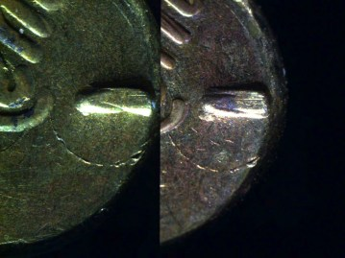
20th century break-throughs
1901 – Dr. Karl Landsteiner – discovered blood types
1010 – Albert Osborn – wrote a book called Questioned Documents that is still used today!
1920 – Colonel Calvin Goddard – developed the comparison microscope

Slide 6
Locard’s exchange principle
Edmond Locard (French) – believed that when 2 objects come into contact with each other, there is an exchange of materials between them
Locard created the first crime lab in the world in Lyon, France in 1910/

Slide 7
Crime Laboratories – a history
Oldest lab in the U.S. – Los Angeles Police Department, created in 1923 by August Vollmer
1932 – FBI organized a national forensics lab that offers services to all law enforcement agencies in the country. It’s the largest lab in the world.
There is NO national system of forensics labs. Local cities, counties, and states operate their own, independent labs
Lab staff sizes and services vary at each location.

Slide 8
Federal labs
Federal Bureau of Investigations
Drug Enforcement Administration
FBI belongs to the Dept. of Justice (DOJ)
FBI has broad investigative powers
DEA belongs to the Dept. of Justice (DOJ)
DEA analyzes drugs and all related items
Enforces drug laws

Slide 9
Federal labs
Bureau of Alcohol, Tobacco, & Firearms
U.S Postal Inspection Services
ATF belongs to the Dept. of the Treasury
Protects citizens from criminal organizations, the illegal use & trafficking of firearms, & the illegal diversion of alcohol & tobacco products
Belongs to the U.S. Postal Service
Investigates criminal investigations related to the integrity & security of the USPS and mail-related laws
Mail theft, mail fraud, identity theft, robberies of post offices, threats on employees, prohibited mail such as drugs, cybercrime

Slide 10
State agencies
Georgia Bureau of Investigation (GBI)
Investigates crimes for counties without their own forensic scientists.
159 counties in GA
Fulton, Cobb, Douglas, Cherokee, Dekalb, Gwinnett, & Chatham (Savannah) have their own labs
7 GBI labs handle the 152 other counties
Offices in Northeast (Cleveland), Northwest (Decatur), Central (Dry Branch), Coastal (Pooler), East (Augusta), West (Midland), and Southwest (Moultrie)

Slide 11
Local Agencies
Cobb County Police Department (CCPD)
Handles regular day to day police work. Have 5 zones plus special operations division that handles SWAT, STEP, K9, and others + detectives
Cobb County Sheriffs Department
Handles the Courts, the jail, serves warrants, and does some investigative work.

Slide 12
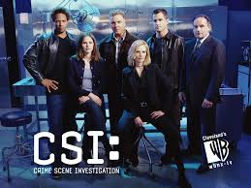
Real forensic science
Real
TV/Movies
Forensic scientists work a crime scene and process evidence in the lab.
They also testify in court.
They DO NOT question suspects.
They are specialized: ballistics experts, fingerprint experts, DNA, etc.
Forensic scientists work a crime scene and process evidence in the lab.
They also testify in court.
They question suspects.
They do everything.

Slide 13
Analysis of physical evidence
Eyewitness accounts are flawed, only physical evidence in free of inherent bias or error.
Scientific method with strict guidelines is used to ensure careful, systematic collection, organization, and analysis of evidence.

Slide 14
Admissibility of evidence in court
The rejection of the scientific validity of the polygraph (lie detector) established a standard guideline for determining the admissibility of scientific examinations in court.
Respiratory rate
Electro-dermal activity
(Sweatiness of fingertips)
Blood pressure/heart rate

Slide 15
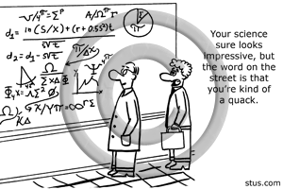
Frye standard
Supreme Court ruled that in order to be admitted as evidence at trial, the questioned procedure, technique, or principles must be “generally accepted” by a meaningful segment of the relevant scientific community.
Usually requires collection of experts to testify or books/papers written on the subject.

Slide 16
Federal rules of evidence
Alternative to the Frye Standard
A witness “qualified as an expert by knowledge, skill, experience, training, or education” may offer expert testimony if
1. There are sufficient facts or data.
2. It is the product of reliable principles & methods
3. The witness has applied the principles & methods reliably to the facts of the case.

Slide 17
Daubert v. Merrill dow pharmaceuticals, inc.
In 1993, the Supreme court asserted that “general acceptance” is not an absolute prerequisite to the admissibility of scientific evidence.
The Court states that trial judges assume the ultimate responsibility for acting as a “gatekeeper” in judging if evidence can be presented in their courts.

Slide 18
Daubert guidelines for admissibility
1. The technique or theory can be tested.
2. The technique or theory has been subject to peer review & publication.
3. The potential rate of error is known.
4. Existence & maintenance of standards controlling the analysis
5. There is widespread scientific acceptance.

