Slide 1
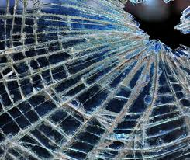
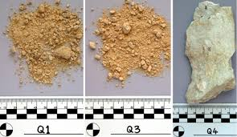
Glass & Soil Evidence

Slide 2
Forensic Analysis of Glass
Glass that is broken and shattered into fragments during the commission of a crime can be used in forensic cases.
Pieces of broken glass from a window or glass objects at a crime scene may be found in a suspect’s clothing or shoes.
Glass particles at car accidents may identify a vehicle.

Slide 3
Composition of Glass
Glass is a hard, brittle, amorphous substance composed of sand (silicon oxides) mixed with metal oxides.
Tempered glass – glass to which strength is added by introducing stress through rapid heating and cooling of the glass surfaces.
Laminated glass – two sheets of ordinary glass bonded together with a plastic film.

Slide 5
Comparing Glass Fragments
The best glass evidence is individualized – a piece fits exactly in a place when all of the fragments are assembled (like a puzzle).
Most fragments are too fragmented or too minute to provide individual evidence.
The physical properties of density and refractive index are most commonly used to classify glass fragments

Slide 6
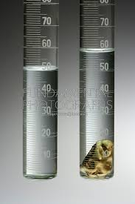
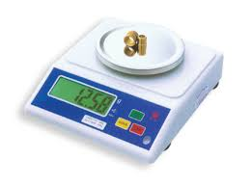
Glass Density
As with any substance, density is equal to mass divided with volume.
Mass is found on a balance (NOT a scale!)
Volume is found using water
displacement.

Slide 7
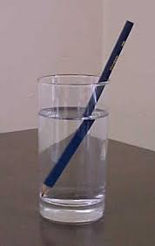
Refractive Index
Refraction – the bending of a light wave caused by a change in its velocity
Refractive index is found using the immersion method.
Refractive index – the ratio of the
speed of light in a vacuum to its
speed in a given medium.

Slide 8
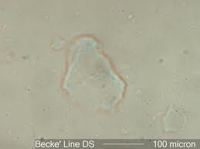
To test for refractive index, the piece of glass is immersed in substances of known refractive index. When the glass “disappears” the refractive index of the glass matches that of the substance.
Becke line - a bright halo observed near the border of a particle immersed in a liquid of a different refractive index.

Slide 9
Glass Fractures
Glass has some flexibility and can stretch slightly when hit.
When it stretches too far it begins to crack.
Radial fracture – a crack in a glass that extends outward like the spoke of a wheel from the point at which the glass was struck.
Concentric fracture- a crack in a glass that forms a rough circle around the point of impact.

Slide 10
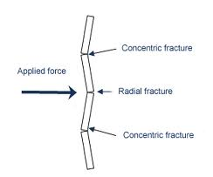
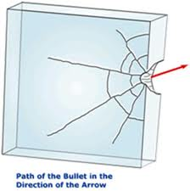
The first fractures in the glass (radial) occur opposite from the side of the impact.
After the radial fractures occur, concentric fractures occur on the side of the impact.
Bullet holes are wider on the exit side and can help determine direction of impact.

Slide 11
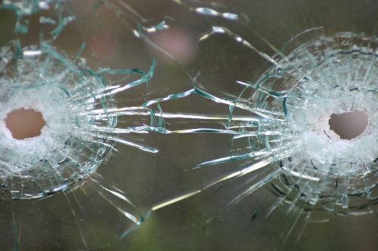

Slide 12
Collection and Preservation of Glass Evidence
If the possibility of putting the glass together exists, it should all be collected.
For hit-and-run scenes, all the broken parts of the headlight and reflector lenses must be collected.
When it can’t be put together, standard/reference glass should be taken from the point closest to the break.

Slide 13
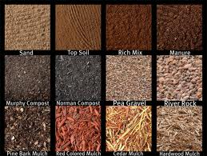
Forensic Analysis of Soil
Most soils can be differentiated by their appearance.
Soil comparisons must be made when the soil has been dried to identical conditions (% H₂O)
There are an estimated 1,000 distinguishable soil colors.

Slide 14
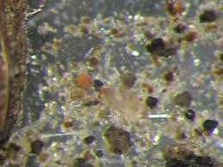
Microscopic Examination of Soil
Low-power microscopic examination reveals plant and animal materials.
High-power microscopic examination allows identification of minerals and rocks.

Slide 15
Density-Gradient Tube (Density Column)
AKA a density column is a glass tube filled from bottom to top with liquids of successfully lighter densities; used to determine the density distribution of soil.
Can also be done with water and
a soil sample.

Slide 16
Collection and Preservation of Soil Evidence
First – establish any variation of soil at the crime-scene area.
Samples should be collected at intervals within a 100yd radius of the crime scene.
Soil samples should also be collected at any alibi locations.
Samples should be taken from the very top layer of soil.

Slide 17
Soil found on suspects should be collected by collecting the object with the soil if possible.
Each object should be wrapped individually.
Garments collected should be placed in paper bags sealed properly to maintain the evidence in the bag.
When collecting soil from a vehicle be sure to collect each sample from different locations on the vehicle in separate containers.

