Slide 1
Explosives

Slide 2
Types of Explosives
Explosion – a chemical or mechanical action resulting in the rapid expansion of gases.
The speed at which explosives decompose varies greatly from one to another and permits their classification as high and low explosives.

Slide 3
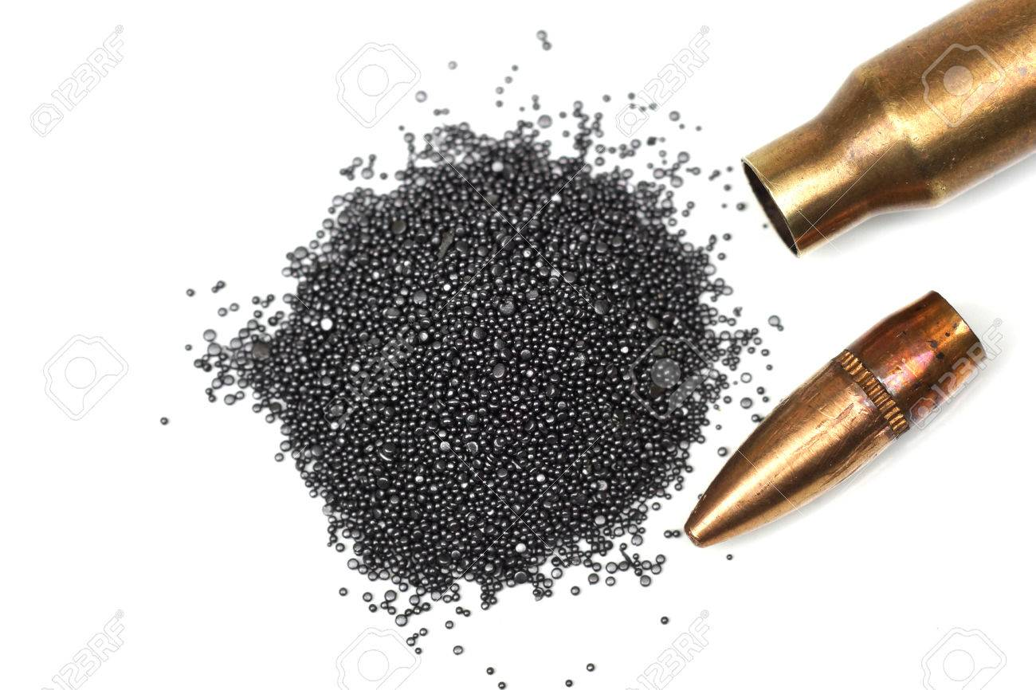
Low explosive – explosive with a velocity of detonation less than 1,000 meters per second. For example, black powder and smokeless powder.

Slide 4
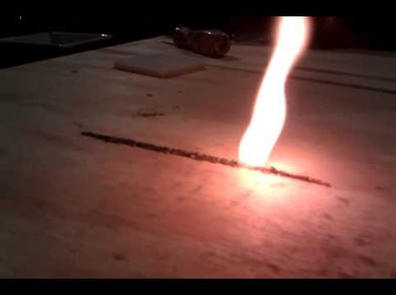
In the low explosive the speed is called speed of deflagration (burning). This is characterized by a very rapid oxidation producing heat, light and a subsonic pressure wave.

Slide 5
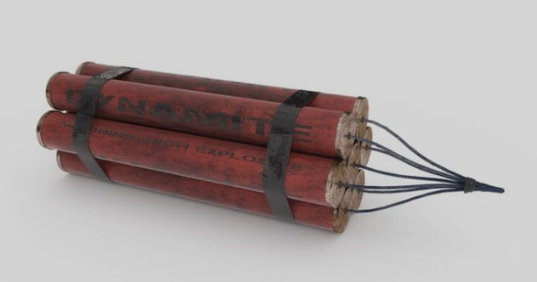
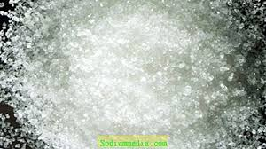
High Explosive – Explosive with a velocity of detonation greater than 1,000 meters per second. For example, dynamite and RDX.

Slide 6
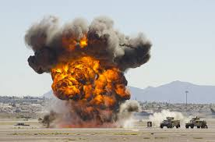
In the high explosive, the speed is called the speed of detonation. Detonation – refers to the creation of a supersonic shock wave within the explosive charge.
This shock wave causes the chemical bonds of the explosive charge to break apart, leading to the new instantaneous buildup of heat and gases.

Slide 7
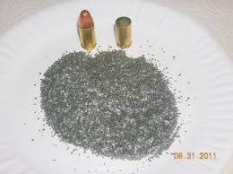
The most widely used low explosives are black powder and smokeless powder.
Black powder is a relatively stable mixture of potassium or sodium nitrate, charcoal, and sulfur. Unconfined, it merely burns. It becomes explosive and lethal when confined.
Safety fuses usually consist of black powder wrapped in a fabric or plastic casing.
The safest and most powerful low explosive is smokeless powder.

Slide 8
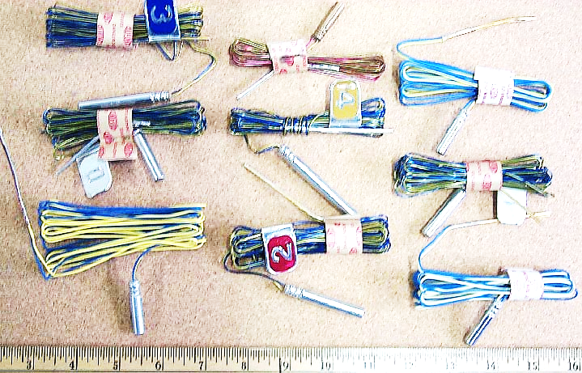
High explosives are classified into two groups by their sensitivity.
Primary explosives – a high explosive easily detonated by heat or shock.
Usually used to detonate other explosives through a chain reaction and are referred to as primers.
Often found in blasting caps.

Slide 9
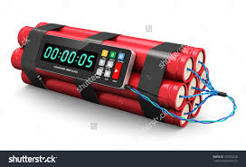
Secondary explosives – are relatively insensitive to heat, shock, or friction, and will normally burn rather than detonate if they are ignited in small quantities in the open air. C-4 Burn
Includes dynamite, TNT (trinitrotoluene), PETN (pentaerythritol tetranitrate), RDX (cyclotrimethylenetrinitramine)

Slide 10
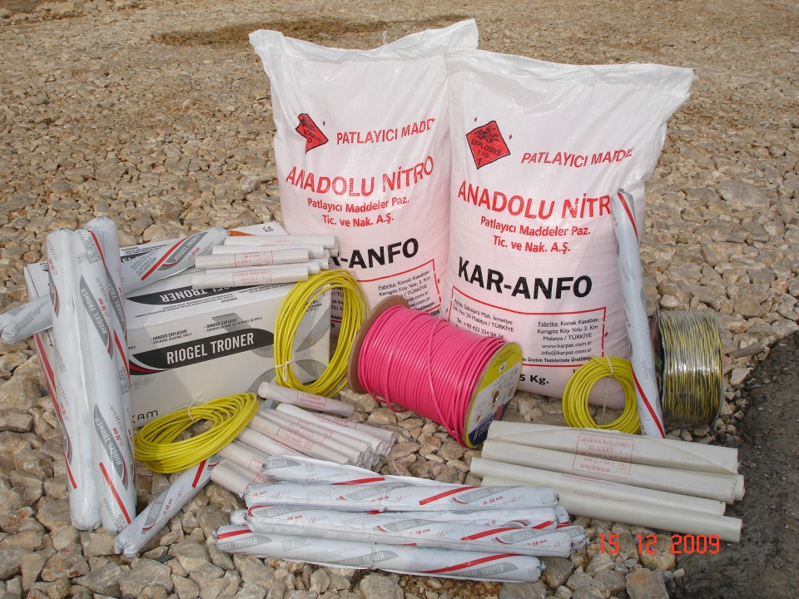
Nitroglycerin-based dynamite has been replaced by ammonium nitrate – based explosives. These explosives mix oxygen-rich ammonium nitrate with a fuel to form a low-cost and very stable explosive.

Slide 11
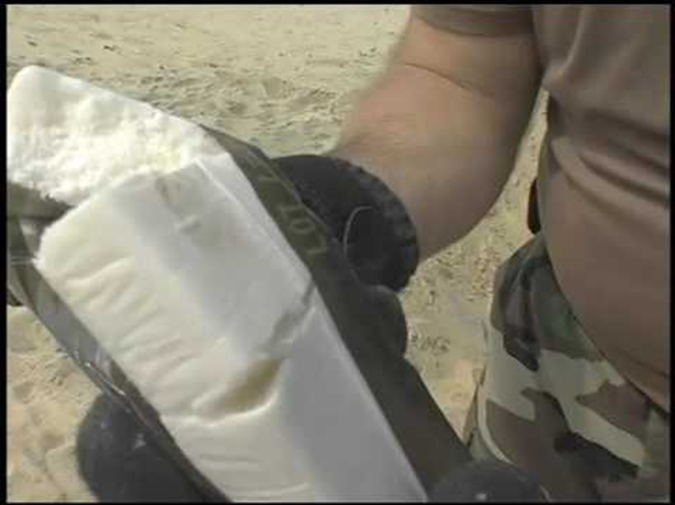
RDX is the most popular and powerful of the military explosives. It is often found in the form of a pliable plastic of doughlike consistency known as C-4.

Slide 12
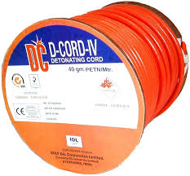
PETN is often used in a detonating cord to connect a series of charges so that they will detonate simultaneously .
Slo-Mo Guys Explosions

Slide 13
VI. Collection & Analysis of Explosives
Most important is collection of samples from the scene containing undetonated residues.
U.S. Bomb Data Center
The U.S. Bomb Data Center was established by congressional mandate in 1996 as a national collection center for information on arson and explosives related incidents throughout the United States.

Slide 14
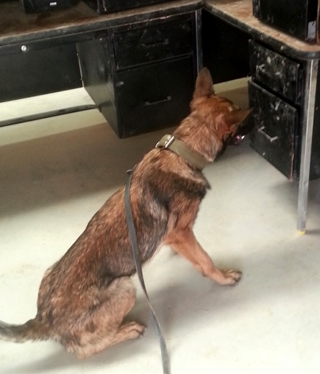
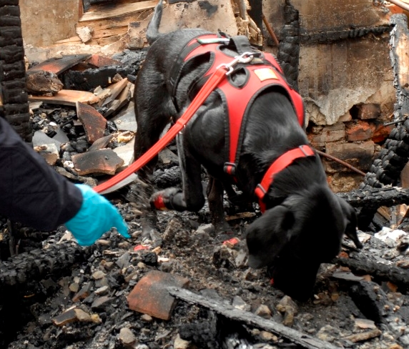
Best Arson &
Explosives Detectors

