Slide 1
Glass Evidence Part 2

Slide 2
Comparing glass fragments
Glass is class evidence unless it can be tied to 1 source.
Can happen only when the suspect & crime scene glass fragmemts are assembled & fitted together like a puzzle

Slide 3
Comparing glass fragments
Most glass evidence is too fragmentary or too small to put the pieces together.
Look to physical properties of the glass to characterize & identify it:
  Density
  Refractive index
    These are class characteristics, not individual characteristics.

Slide 4
Measuring & comparing density
Density = mass/volume
Glass does not usually have a completely homogeneous density throughout – do its density will be a range

Slide 5
Density - Flotation method
Flotation method to determine density.
  A standard/reference sample glass particle is immersed in a liquid (bromoform & bromobenzene)
  The density of the liquid is adjusted so that the glass particle will remain suspended in the middle of the liquid.
  Then the glass and the liquid have the same density
  Now other glass chips are tested in the liquid to see if they sink, float to the top or remain suspended.

Slide 6
Refractive index - refraction
The bending of light as it moves from 1 substance to another
Can make it seem like an object is lying at a higher point than it really is

Slide 7
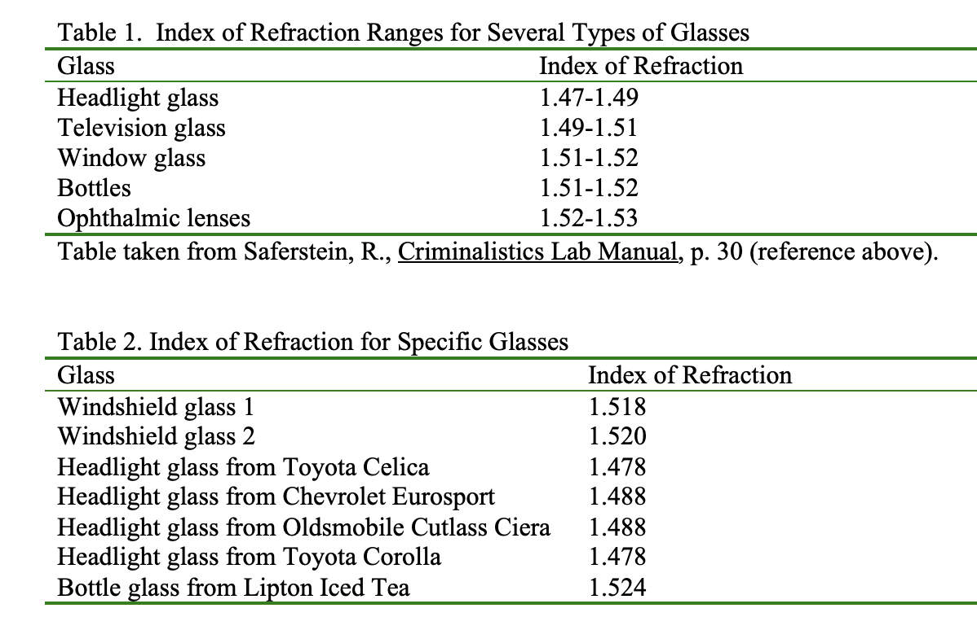
Refractive index
Ratio of the speed of light in a vacuum to its speed in a given medium (glass)
RI = speed of light in vacuum
speed of light in medium

Slide 8
Determining & comparing refractive index – immersion method
Glass particles are immersed in a liquid whose refractive index is known.
If the glass & the liquid have the same refractive index, the glass seems to disappear.

Slide 9
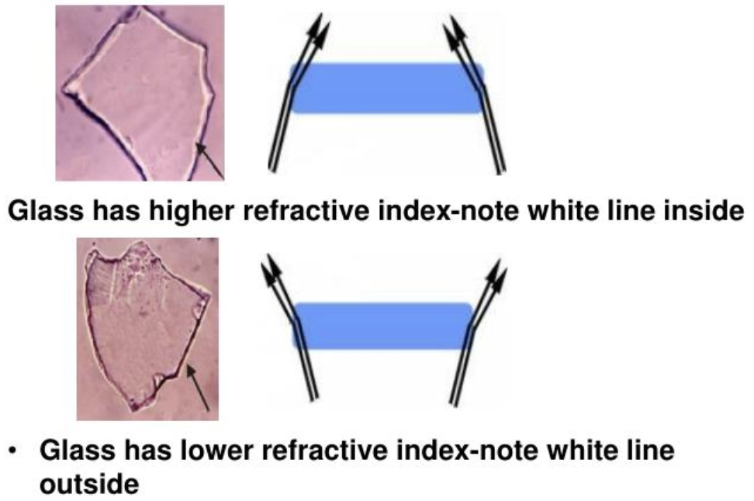
Determining & comparing refractive index – immersion method
If the glass & the liquid do not have the same refractive index – becke lines will appear

Slide 10
Collection & preservation of glass evidence
Collect all glass found at crime scene
  Packaged in solid containers to avoid breakage, indicate interior & exterior sides
  Check suspect’s clothes for fragments, wrap in paper bindles
Submit all glass evidence found in the possession of the supect along with a sample of broken glass fr0k crime scene
  Standard/reference sample – should be taken from any remaining glass in window or door frame, as close as possible to the point of breakage

