Slide 1
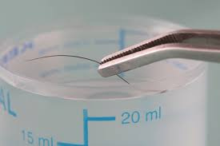
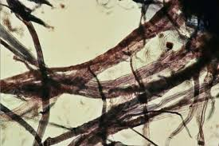
Hair and Fiber Evidence
Unit 2A

Slide 2
Forensic Examination of Hair

Slide 3
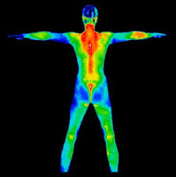
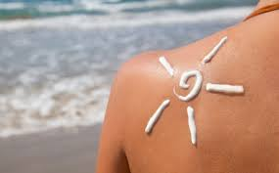
Humans have hair to…
to regulate body temperature, decrease friction, and protect against sunlight.

Slide 4
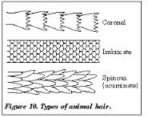
Morphology of Hair
Hair is an appendage of the skin that grows out of an organ known as the hair follicle.
Hair is composed of three layers – the cuticle, the cortex and the medulla.
Cuticle – the scale
structure covering the
exterior of the hair.

Slide 5
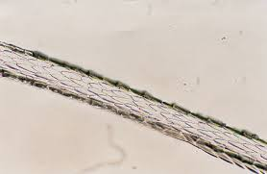
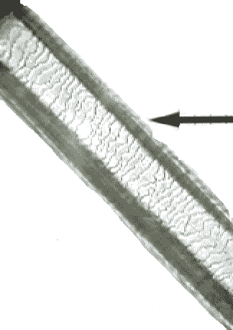
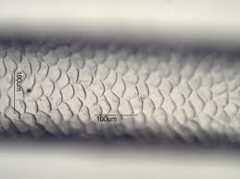
Imbricate
Spinous
Coronel

Slide 6
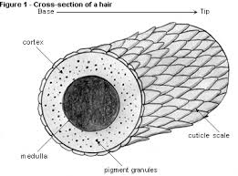
Cortex – the main body of the hair shaft.
The cortex contains the pigment granules that give hair its color.

Slide 7
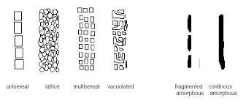
Medulla – a cellular column running through the center of the hair.
Human medulla patterns include
as well as solid and
none
Animal medulla patterns include:

Slide 8
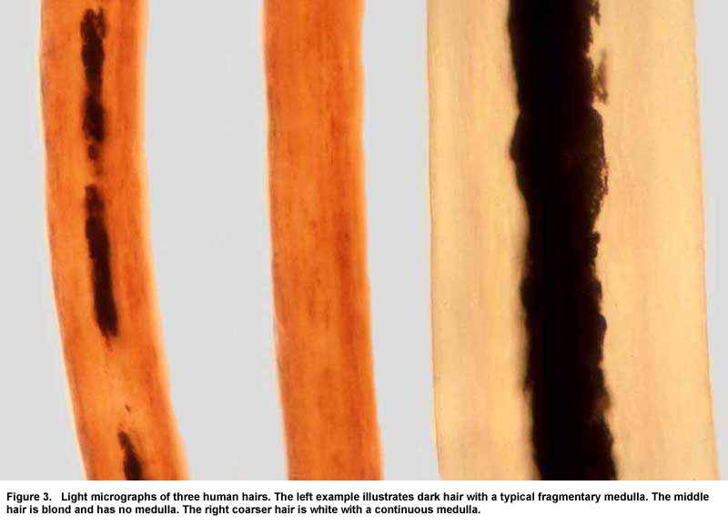
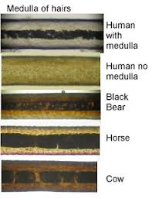
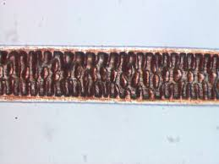

Slide 9
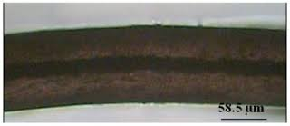
Medullary Index
Medullary index is the ratio of the diameter of the medulla to the diameter of the hair shaft.
For humans, the index is generally less than one-third; for most other animals, the index is one-half or greater.

Slide 10
Phases of Hair Growth
Human head hair grows in three developmental stages, and the shape and size of the hair root is determined by the hair’s current growth phase.
Anagen phase – the initial growth phase during which the hair follicle actively produces hair.

Slide 11
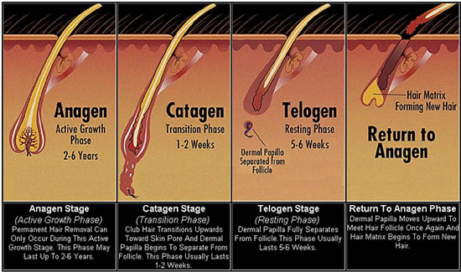
Catagen phase – a transition stage between the anagen and telogen phases of hair growth.
Telogen phase – the final growth phase in which hair naturally falls out of the skin.

Slide 12
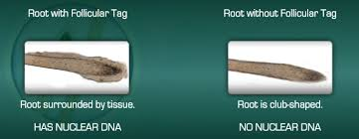
Follicular tag – a translucent piece of tissue surrounding the hair’s shaft near the root that contains the richest source of DNA associated with hair.

Slide 13
Factors in Comparison of Hair
Not all hair on a person is the same!
Primary comparison features are color, length, and diameter.
Other features include medulla pattern as well as pigment granule color and distribution.
Hair that has been dyed or bleached can often be identified through microscopic examination.

Slide 14
DNA in Hair
While we learn more about DNA in a later chapter, it can be part of hair evidence.
If a hair contains a root (follicular tag) it has been pulled out from the scalp and therefore may contain nuclear DNA.
Nuclear DNA – DNA that is present in the nucleus of a cell and that is inherited from both parents.

Slide 15
If the hair does not contain a root, it will not have nuclear DNA. It does however have mitochondrial DNA.
Mitochondrial DNA - DNA present in small structures (mitochondria) outside the nucleus of a cell.
Mitochondrial DNA is inherited from the mother.
When collecting standard/reference samples, 50 full length head hairs and 24 full length pubic hairs are taken.

Slide 16
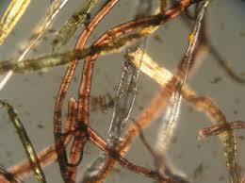
Forensic Examination of Fibers

Slide 17
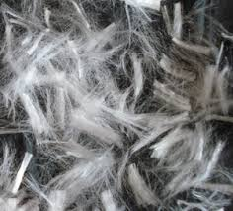
Fiber Evidence Collection
Critical in the first 24 hours. After that it is estimated that 95% of all fibers are lost.

Slide 18
Types of Fibers - Natural
Natural fibers – fibers derived entirely from animal or plant sources.
Includes 1. Animal hairs – wool, mohair,
cashmere, furs, and silk
2. Plant fibers – cotton, coir, hemp,
jute, sisal, and flax
3. Mineral fibers – asbestos, fiberglass

Slide 19
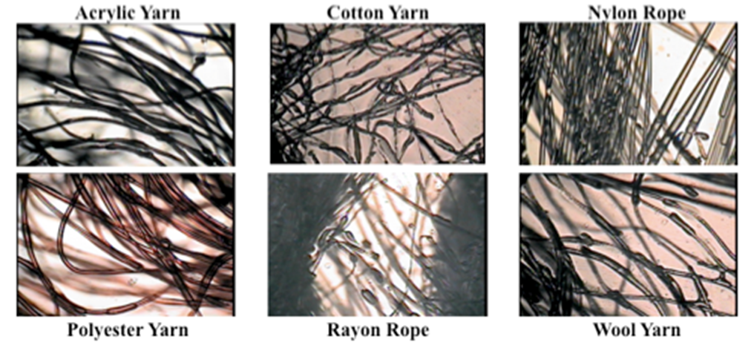
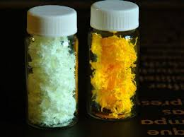
Types of Fibers - Synthetic
AKA Manufactured fibers – fibers derived from either natural or synthetic polymers.
Includes materials such as acetate, acrylic, melamine, nylon, polyester, rayon, and spandex.

Slide 20
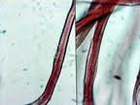
Fiber Identification
Microscopic Examination
- Color and diameter match are critical.

Slide 21
Analytic Techniques Used in Fiber Examination
Chemical Composition – there are numerous chemical tests that can be performed but they are all destructive.
Birefringence (refractive differences) – polarized white light is used and is nondestructive.
Infrared Absorption – fibers absorb light and vibrate at specific frequencies. (nondestructive)

Slide 22
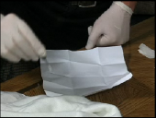
Collection and Preservation of Fiber Evidence
Relevant articles of clothing should be packaged carefully in paper bags.
Care must be taken to keep articles from touching other articles.
Loose fibers should be collected and packaged in paper bindles.

