Slide 1
Electrons and Light
Valence electrons
Electromagnetic Spectrum
Light characteristics
Electrons and Light

Slide 2
Valence e⁻
Fe – 1s²2s²2p⁶3s²3p⁶4s²3d⁶ {2 valence e⁻}
Rb – 1s²2s²2p⁶3s²3p⁶4s²3d¹⁰ 4p⁶ 5s¹ {1 valence e⁻}
Cl – 1s²2s²2p⁶3s²3p⁵ {7 valence e⁻}
These are the electrons that are involved in bonding and chemical reactions!!!!!!!

Slide 3
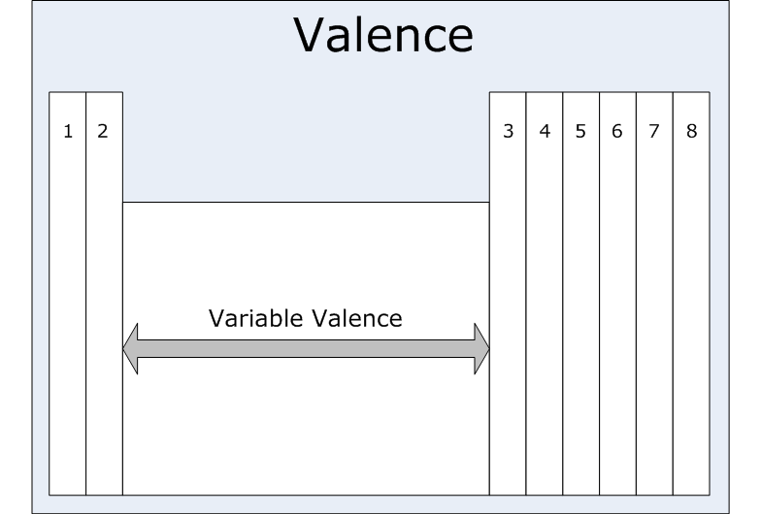
Valence Electrons and the Periodic Table

Slide 4
What do e⁻ have to do with light?
When you add energy to an element (perhaps by heating it up), the valence e⁻ get “excited”. In other words they jump up to a higher energy level or orbital.
BUT… they are unstable up there. So they release that added energy in the form of colored light!
Huh?

Slide 5
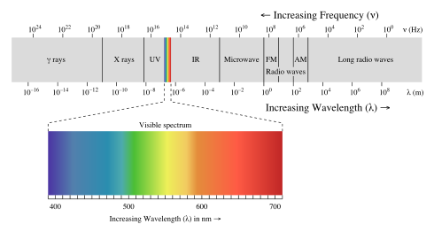
Electromagnetic Spectrum

Slide 6
Light Characteristics
Light moves in wave from the light source to you eye or other detector!
Waves have several characteristics!

Slide 7
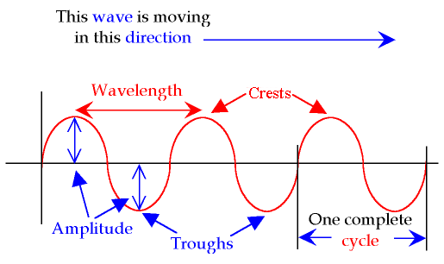
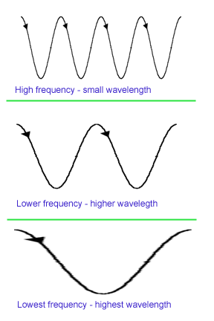
Wave Characteristics
Speed of light = wavelength × frequency
speed of light = 300,000,000 meters/ sec.
Since the speed of light is constant, then if wavelength increases, then frequency has to decrease!

Slide 8
Light can also act as particles, we call them PHOTONS!!!!!!
Moving along those waves, there are little packets of energy called photons.
Photons have specific amounts of energy as determined by the frequency of the light.
Energy= Planck’s constant × frequency
The higher the frequency of the light, the more energy the light has.

Slide 9
So how does light tie into excited electrons?
When you add energy to an element, it’s valence e⁻ absorb that packet of energy & become unstable. In order to return to stability (lower their energy) they “spit out” that energy in the form of a photon that has a frequency in the visible light part of the electromagnetic spectrum that we can see.

Slide 10
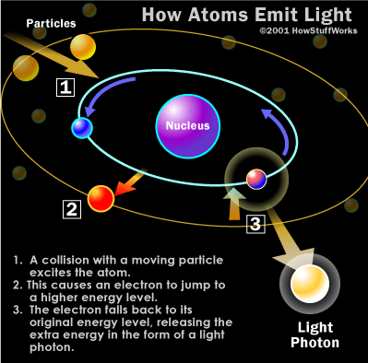

Slide 12
Lab: Flame Test Procedure
Light Bunsen burner.
Take a soaked wooden splint from the bottle. (note the 1st element in the solution.)
Hold splint in flame. Observe flame color and record.
Rinse splint in water.
Dispose of all used splints in trash. Turn off Bunsen burner.

