Slide 1
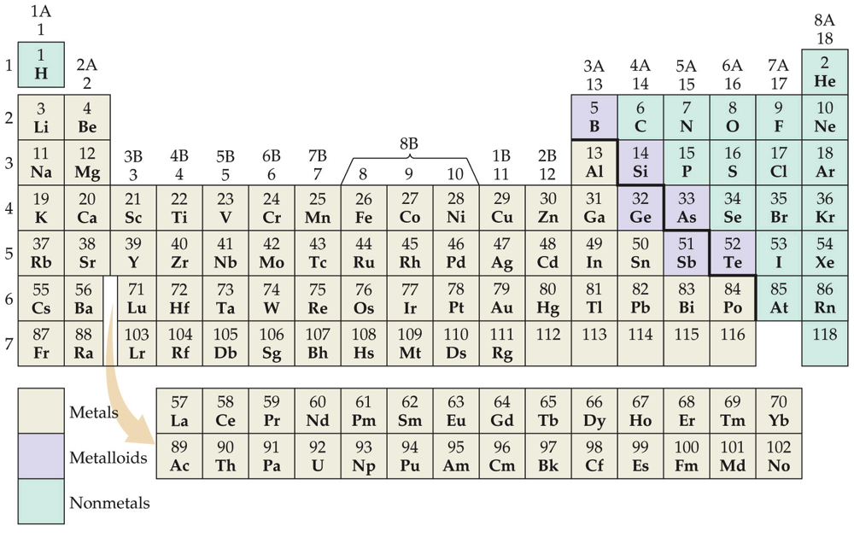
Periodic Table
Nonmetals are on the right side of the periodic table (with the exception of H).

Slide 2
Periodic Table
Metalloids border the stair-step line (with the exception of Al, Po, and At).

Slide 3

Periodic Table
Metals are on the left side of the chart.

Slide 4
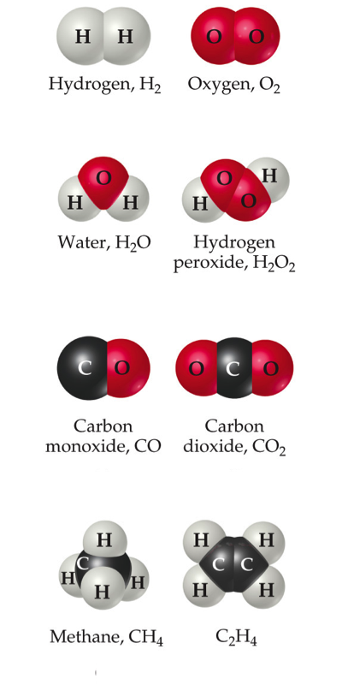
Chemical Formulas
The subscript to the right of the symbol of an element tells the number of atoms of that element in one molecule of the compound.

Slide 5
Chemical Formulas
Molecular compounds are composed of molecules and almost always contain only nonmetals.

Slide 6
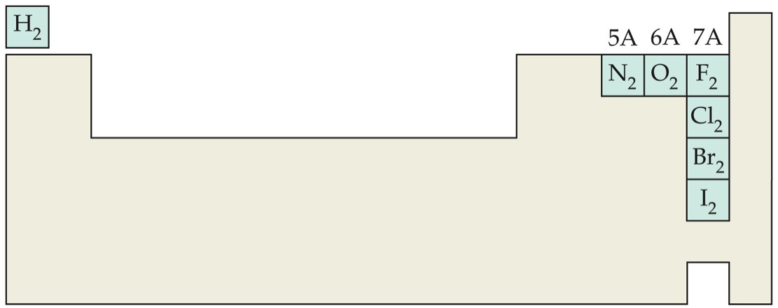
Diatomic Molecules
These seven elements occur naturally as molecules containing two atoms.

Slide 7
Types of Formulas
Empirical formulas give the lowest whole-number ratio of atoms of each element in a compound.
Molecular formulas give the exact number of atoms of each element in a compound.

Slide 8
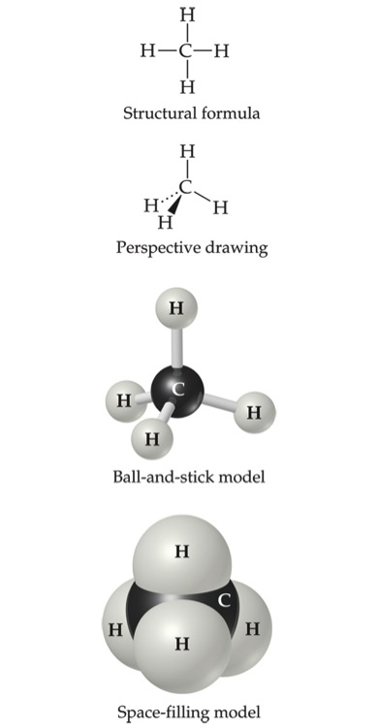
Types of Formulas
Structural formulas show the order in which atoms are bonded.
Perspective drawings also show the three-dimensional array of atoms in a compound.

Slide 9
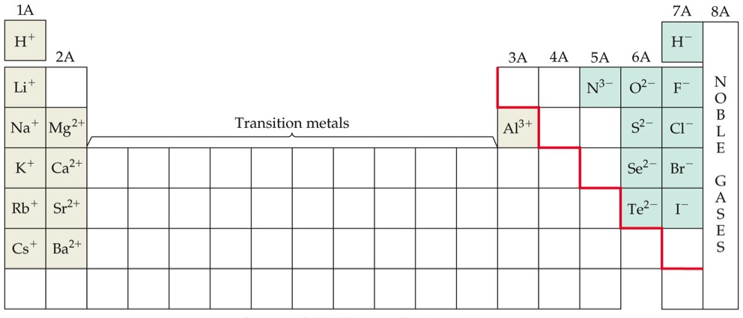
Ions
When atoms lose or gain electrons, they become ions.
  Cations are positive and are formed by elements on the left side of the periodic chart.
  Anions are negative and are formed by elements on the right side of the periodic chart.

Slide 10
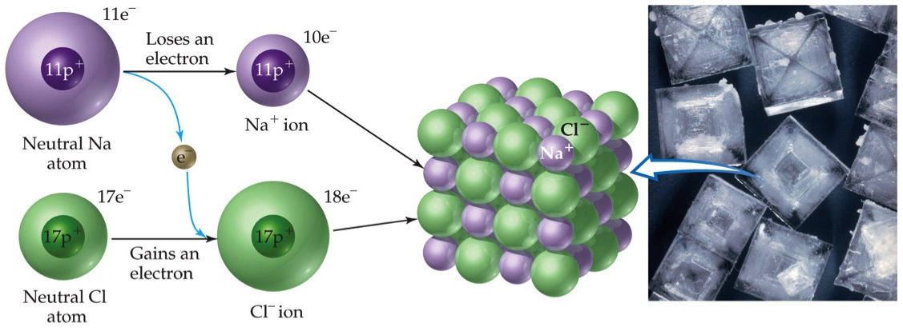
Ionic Bonds
Ionic compounds (such as NaCl) are generally formed between metals and nonmetals.

Slide 11
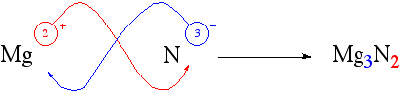
Writing Formulas
Because compounds are electrically neutral, one can determine the formula of a compound this way:
  The charge on the cation becomes the subscript on the anion.
  The charge on the anion becomes the subscript on the cation.
  If these subscripts are not in the lowest whole-number ratio, divide them by the greatest common factor.

Slide 12
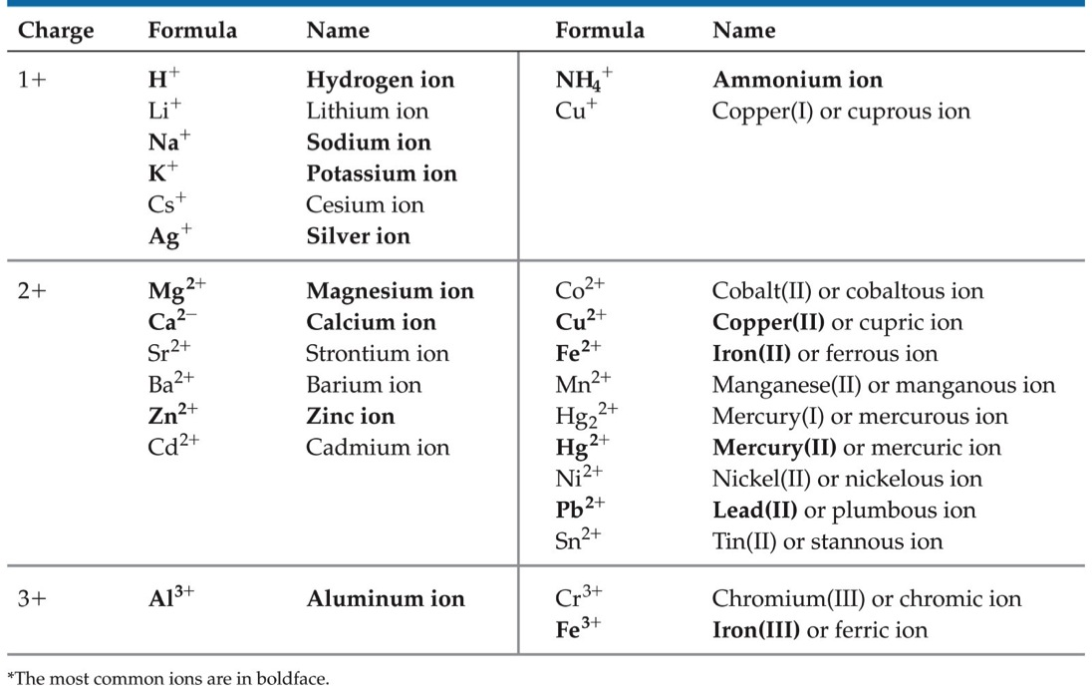
Common Cations

Slide 13
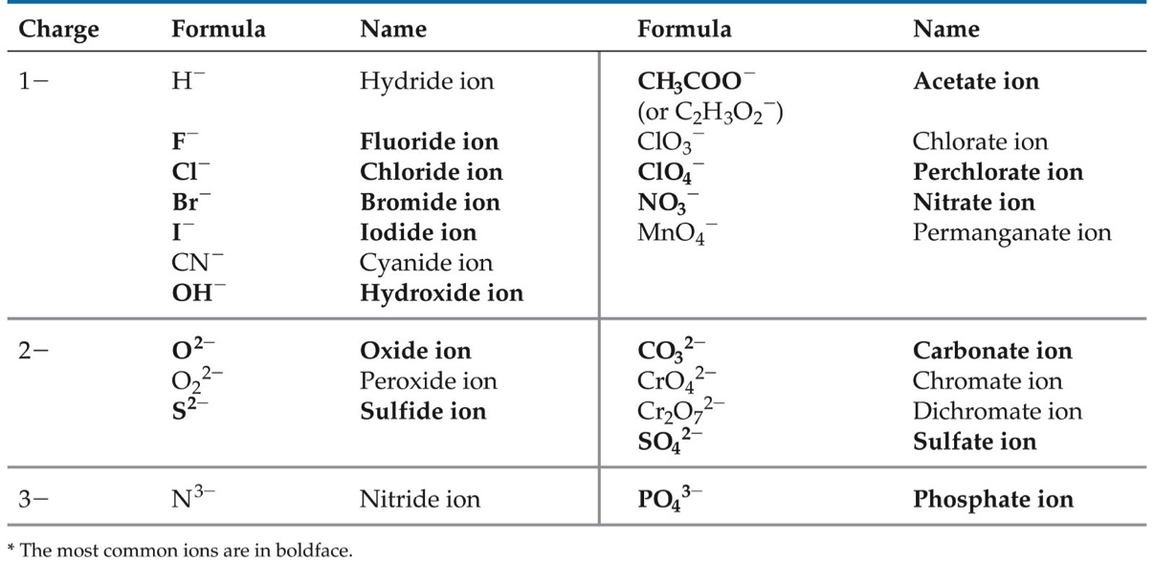
Common Anions

Slide 14
Inorganic Nomenclature
Write the name of the cation.
If the anion is an element, change its ending to -ide; if the anion is a polyatomic ion, simply write the name of the polyatomic ion.
If the cation can have more than one possible charge, write the charge as a Roman numeral in parentheses.

Slide 15
Patterns in Oxyanion Nomenclature
When there are two oxyanions involving the same element:
  The one with fewer oxygens ends in -ite.
    NO₂⁻ : nitrite; SO₃²⁻ : sulfite
  The one with more oxygens ends in -ate.
    NO₃⁻ : nitrate; SO₄²⁻ : sulfate

Slide 16
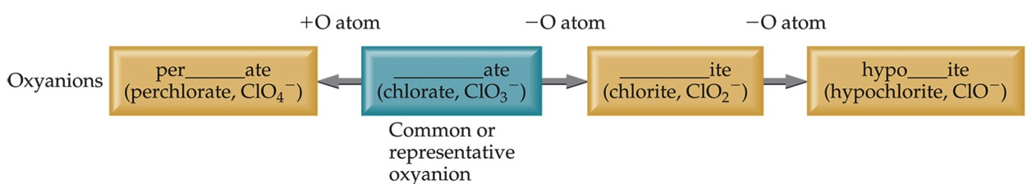
Patterns in Oxyanion Nomenclature
The one with the second fewest oxygens ends in -ite.
    ClO₂⁻ : chlorite
The one with the second most oxygens ends in -ate.
    ClO₃⁻ : chlorate

Slide 17
Patterns in Oxyanion Nomenclature
The one with the fewest oxygens has the prefix hypo- and ends in -ite.
    ClO⁻ : hypochlorite
The one with the most oxygens has the prefix per- and ends in -ate.
    ClO₄⁻ : perchlorate

Slide 18
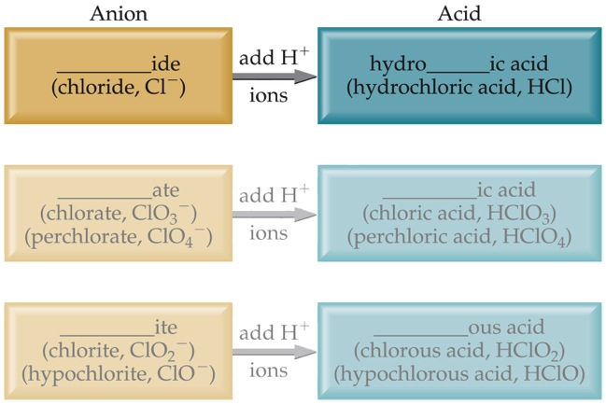
Acid Nomenclature
If the anion in the acid ends in -ide, change the ending to -ic acid and add the prefix hydro- .
  HCl: hydrochloric acid
  HBr: hydrobromic acid
  HI: hydroiodic acid

Slide 19
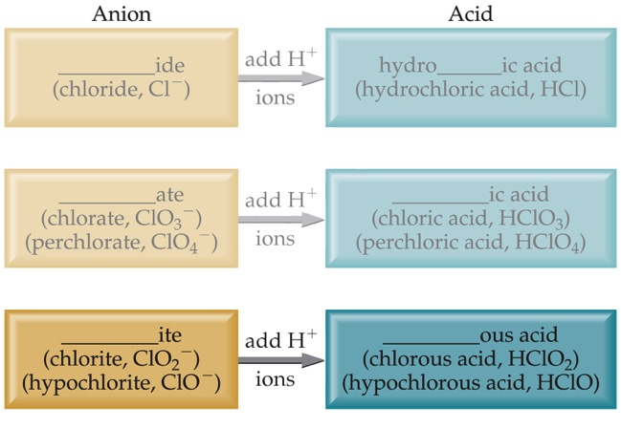
Acid Nomenclature
If the anion in the acid ends in -ite, change the ending to -ous acid.
  HClO: hypochlorous acid
  HClO₂: chlorous acid

Slide 20
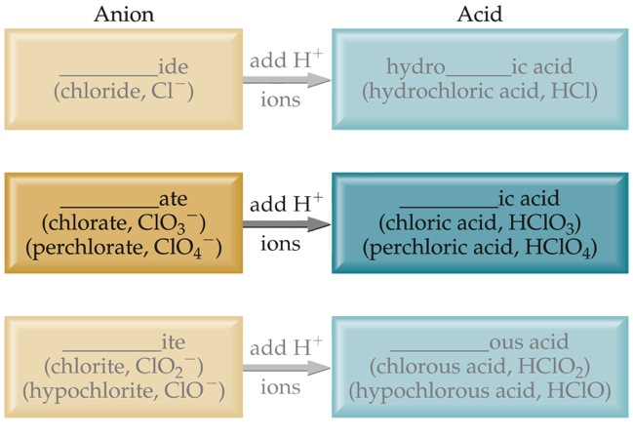
Acid Nomenclature
If the anion in the acid ends in -ate, change the ending to -ic acid.
  HClO₃: chloric acid
  HClO₄: perchloric acid

Slide 21
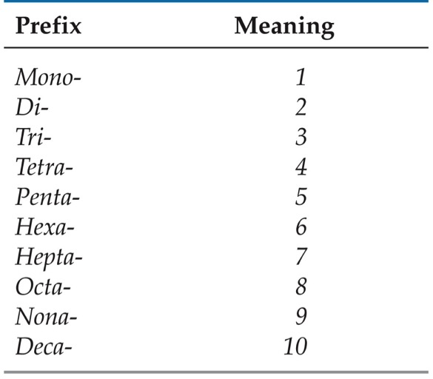
Nomenclature of Binary Compounds
The less electronegative atom is usually listed first.
A prefix is used to denote the number of atoms of each element in the compound (mono- is not used on the first element listed, however) .

Slide 22
Nomenclature of Binary Compounds
The ending on the more electronegative element is changed to -ide.
  CO₂: carbon dioxide
  CCl₄: carbon tetrachloride

Slide 23
Nomenclature of Binary Compounds
If the prefix ends with a or o and the name of the element begins with a vowel, the two successive vowels are often elided into one.
N₂O₅: dinitrogen pentoxide

Slide 24
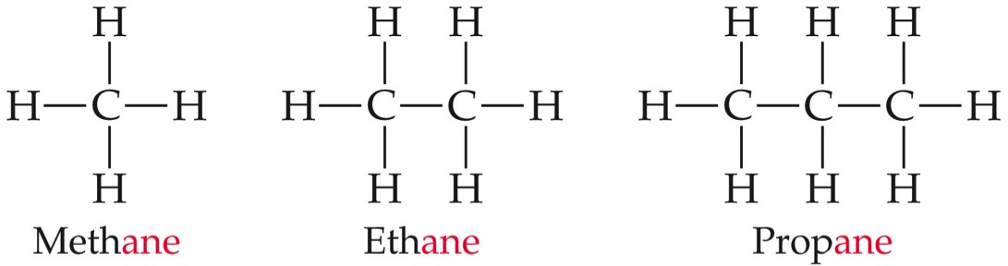
Nomenclature of Organic Compounds
Organic chemistry is the study of carbon.
Organic chemistry has its own system of nomenclature.

Slide 25
Nomenclature of Organic Compounds
The simplest hydrocarbons (compounds containing only carbon and hydrogen) are alkanes.

Slide 26
Nomenclature of Organic Compounds
The first part of the names above correspond to the number of carbons (meth- = 1, eth- = 2, prop- = 3, etc.).

Slide 27
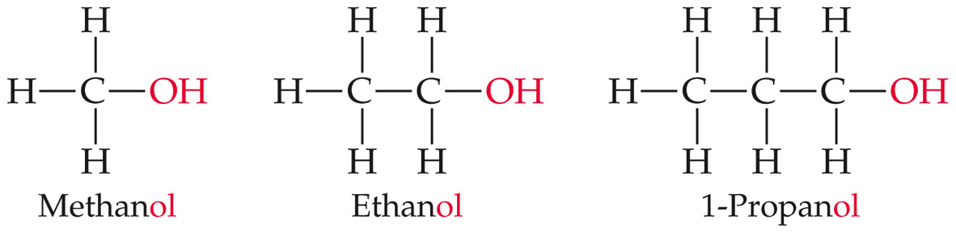
Nomenclature of Organic Compounds
When a hydrogen in an alkane is replaced with something else (a functional group, like -OH in the compounds above), the name is derived from the name of the alkane.
The ending denotes the type of compound.
  An alcohol ends in -ol.

