Slide 1
Nuclear Chemistry
Part 2

Slide 2
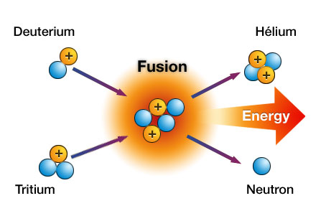
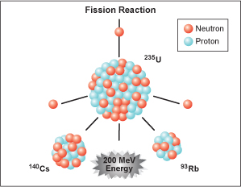
Fission vs. Fusion
Fission
Fusion
A larger nucleus splits into smaller pieces
Creates a lot of energy
Used in nuclear bombs and nuclear power plants
2 smaller nuclei are fused together to create a larger one
Creates even MORE energy that fission
Can only occur at very high temperatures- millions of degrees.

Slide 3
Elements formed from FUSION in stars
https://www.youtube.com/watch?v=neMEo8ZrwuI

Slide 4
Elements formed from FUSION in stars
Young stars start by fusing hydrogen (H) into helium (He) and continuing until they hit the element iron Fe).
At that point, the star does not have enough power to create any more elements as it is dying.
If an old star is massive enough, it will go supernova or hypernova and the rest of the natural elements can be made.

Slide 5
Supernova
A supernova is the explosive death of a star, which unleashes a burst of light through the cosmos. Supernovas happen in two different ways:
When massive stars run out of fresh nuclear fuel, there is no more pressure to sustain them against their own weight. The central part of such a star then collapses. The outer layers of the star fall in on the core and then rebound in a tremendous explosion.
Matter piling up on the compressed core of an already-dead star, known as a white dwarf, can reach sufficient density to trigger a thermonuclear explosion
http://www.redorbit.com/news/video/education_1/1112748802/what-is-a-supernova/

Slide 6
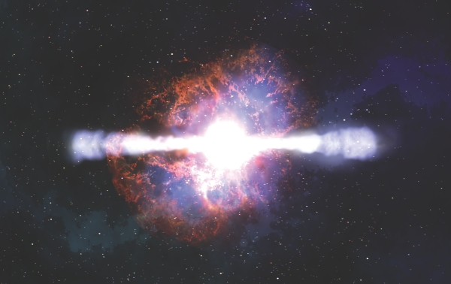
Hypernovas
A hypernova, also known as a collapsar, is an extremely energetic supernova.
In a supernova, a star shears off its outer matter but leaves a new star at its centre, often a neutron star. In a hypernova, the force of the explosion tears the inner star apart too. Hypernovas occur in stars with a mass greater than 30 times that of our Sun.
Hypernovas are incredibly rare.

Slide 7
Half-Life
Remember how radioactive substances give off alpha, beta, and/or gamma particles?
The time it takes for half the amount of a substance to decay away is called HALF-LIFE (t_{1/2})
Example- the half-life of radium is 30 seconds. That means every 30 seconds, half of any amount of radium decays into something else.
Will it ever completely go away?

