Slide 1
Pure Substances
Matter

Slide 2
2 types of pure substances
Elements
Substances that cannot be decomposed into simpler substances by chemical and physical changes.
118 known elements
Made of atoms
Compounds
Substances made by bonding together 2 or more atoms in specific ways
Molecule- a collection of atoms bonded together that behave as a unit

Slide 3
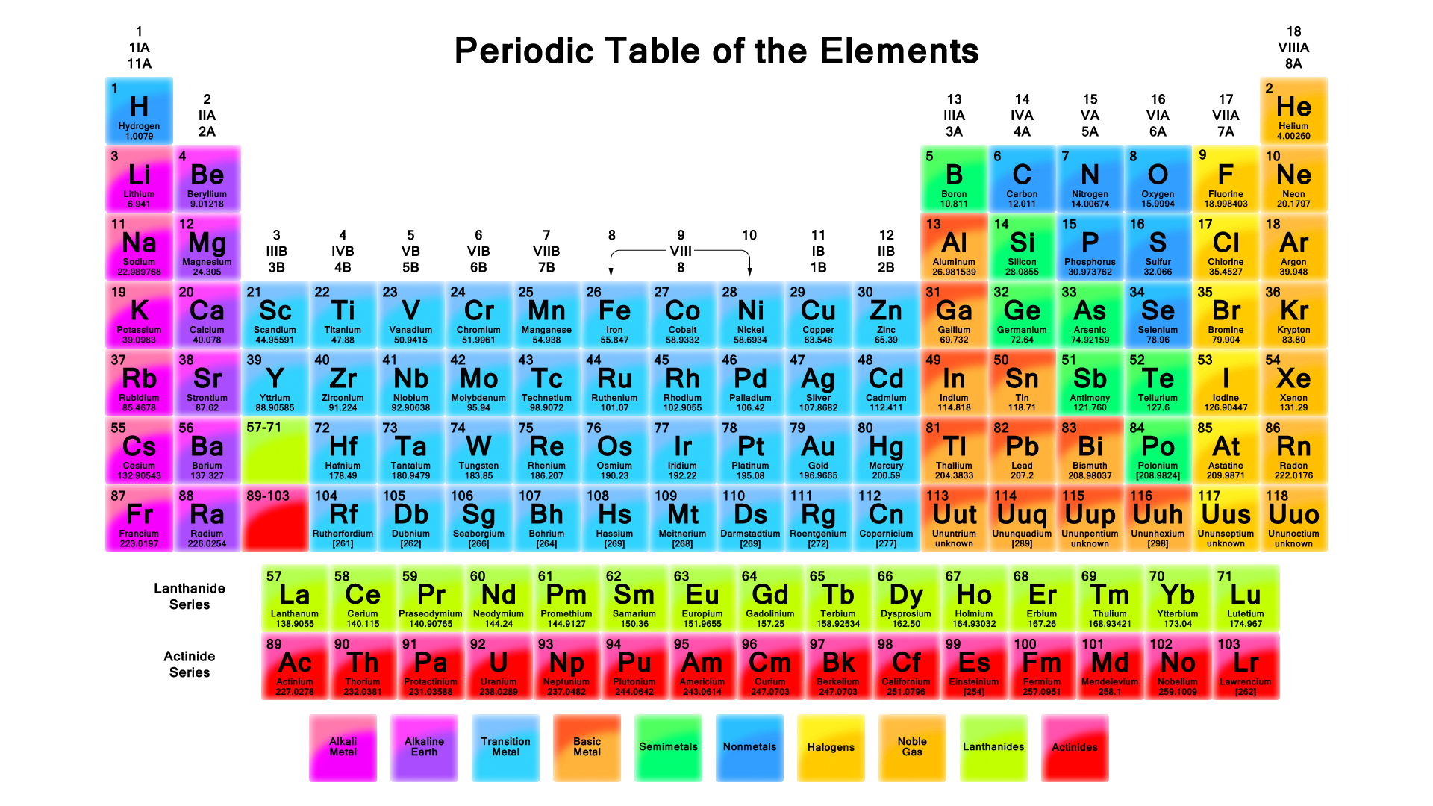
Elements- listed on the Periodic Table

Slide 4
Atomic #
Name
Atomic Mass

